Slide 1
BATTLE READY
Psalms 144:1

Slide 2
“YOUR BREAKTHROUGHS”

Slide 3
PARADIGM:
YOU, 5 STAR GENERAL
ROUTINES:
PERSONAL REALM
BODY
SPIRIT
MIND
SOUL
INITIATIVES:
FAMILY
KINGDOM
PROFESSIONAL
SPOUSE
CHURCH
CAREER
CHILDREN
WORLD
RESOURCES

Slide 4
HABIT DEVELOPMENT IN THE PERSONAL REALM
BODY
MIND
SPIRIT
SOUL

Slide 5
BATTLE READY TRANSFORMATION GYM
BODY
SPIRIT
MIND
SOUL
NO PAIN, NO GAIN

Slide 6
CALLING
SIGNIFICANCE
TRANSITION
TRANSITION
TRAINING
TRAINING
BATTLE READY
VISION
VISION
WORK
FAMILY
CHURCH
FAITH

Slide 7
PARABLE OF THE SEEDS
This is the meaning of the parable: The seed is the word of God. Those along the path are the ones who hear, and then the devil comes and takes away the word from their hearts, so that they may not believe and be saved. Those on the rocky ground are the ones who receive the word with joy when they hear it, but they have no root. They believe for a while, but in the time of testing they fall away. The seed that fell among thorns stands for those who hear, but as they go on their way they are choked by life’s worries, riches and pleasures, and they do not mature. But the seed on good soil stands for those with a noble and good heart, who hear the word, retain it, and by persevering produce a crop.
LUKE 8:11-18

Slide 8
CALLS OF GOD

Slide 9
SPIRIT
1
CALL TO CONVERSION
BIRTH DEATH
Notes:
When we hear Jesus say “follow me” and we said yes.

Slide 10
MIND
BODY
SOUL
CALL TO TRANSFORMATION
2
SPIRIT
1
CALL TO CONVERSION
BIRTH DEATH
Notes:
This is the one that MOST Christians don’t do
We are called to change and be in accordance with God’s laws
Moving from having our spirt renewed to having that flow to earth by renewing your mind body and soul
The call to transformation is the PERSONAL RELM

Slide 11
Do not be conformed to this age, but be transformed by the renewing of your mind, so that you may discern what is the good, pleasing, and perfect will of God.
Romans 12:2
Notes:
This is mission critical to battle ready

Slide 12
CALL TO TRANSFORMATION
2
FOLLOW UP GAP
1
CALL TO CONVERSION
BIRTH DEATH
Notes:
The follow up gap is the time between saying yes to Jesus and ACTUALLY following Jesus. You may actually still be in this space this morning.
If you have not began to take territory in your mind, body, soul where would you say you are?

Slide 13
CALL TO FAITHFULNESS
3
CALL TO TRANSFORMATION
2
FOLLOW UP GAP
1
CALL TO CONVERSION
BIRTH DEATH
Notes:
Call to faithfulness is about our biblically given roles

Slide 14
CALL TO FAITHFULNESS
3
GOD GIVEN BIBLICAL ROLES:
HUSBAND/WIFE FATHER/MOTHER WORKER STEWARD
BIRTH DEATH
Notes:
How can we be responsible for what God’ has for us externally if we are not being responsible in the roles that God has put in us? We must first practice this faithfulness before we can move out from there.

Slide 15
CALL TO FRUITFULNESS
4
CALL TO FAITHFULNESS
3
CALL TO TRANSFORMATION
2
FOLLOW UP GAP
1
CALL TO CONVERSION
BIRTH DEATH
Notes:
These calls naturally land us in a call to fruitfulness.
The scripture for this is

Slide 16
As they were worshiping the Lord and fasting, the Holy Spirit said, “Set apart for me Barnabas and Saul for the work to which I have called them.”
ACTS 13:2
Notes:
We are called to work. This call was there before the beginning of time.

Slide 17
CALL TO FRUITFULNESS
4
HUSBAND
FATHER
CALL TO FAITHFULNESS
3
WORKER
STEWARD
MIND
CALL TO TRANSFORMATION
2
BODY
SOUL
FOLLOW UP GAP
SPIRIT
1
CALL TO CONVERSION
BIRTH DEATH
Notes:
Have you answered that call?
There is an order in how we move from one call to another.
How many have you seen answer a call to fruitfulness and seen them implode?
That is because they had not taken the transformation or faithfulness seriously.

Slide 18
GROWTH - CALL TO TRANSFORMATION

Slide 19
WHAT DOES THE WORD OF GOD SAY ABOUT GROWTH AND TRANSFORMATION?
“And he himself gave some to be apostles, some prophets, some evangelists, some pastors and teachers, to equip the saints for the work of ministry, to build up the body of Christ, until we all reach unity in the faith and in the knowledge of God’s Son, growing into maturity with a stature measured by Christ’s fullness…
Notes:
Why did God give us those people?
To reach the FULL MEASURE OF CHRIST.
Are we there yet? This is the call to transformation.

Slide 20
…Then we will no longer be little children, tossed by the waves and blown around by every wind of teaching, by human cunning with cleverness in the techniques of deceit. But speaking the truth in love, let us grow in every way into him who is the head—Christ. From him the whole body, fitted and knit together by every supporting ligament, promotes the growth of the body for building itself up in love by the proper working of each individual part.”
EPHESIANS 4:11-16
Notes:
Growth is in play.
BUT…….INSTEAD
Each of us has to do our work
Each of us has to grow

Slide 21
“assuming you heard about him and were taught by him, as the truth is in Jesus, to take off your former way of life, the old self that is corrupted by deceitful desires, to be renewed in the spirit of your minds, and to put on the new self, the one created according to God’s likeness in righteousness and purity of the truth.”
EPHESIANS 4:21-24
Notes:
Here Paul is telling us EXACTLY what Biblical growth and maturity looks like.
Here is how Jesus does this in us.

Slide 22
TRANSFORMATION PROCESS
1.
UNCONSCIOUS INCOMPETENCE
YOU ARE UNAWARE AND YOU DON’T KNOW IT
Notes:
Isn’t it beautiful that is so much we are doing wrong and Jesus doesn’t bombard us with all of them.
He shows us one at a time….

Slide 23
“You were taughT…take off your former way of life, the old self that is corrupted by deceitful desires, to be renewed in the spirit of your minds, and to put on the new self,” Ephesians 4:22
CONSCIOUS INCOMPETENCE
YOU BECOME AWARE OF ONE AREA OF NEEDED GROWTH
2.
1.
UNCONSCIOUS INCOMPETENCE
YOU ARE UNAWARE AND YOU DON’T KNOW IT
Notes:
Jesus makes us aware and calls us to that area. Again, not all at once, just one area.
Imagine if everything was brought to the surface at once?

Slide 24
CONSCIOUS COMPETENCE
YOU SUCCESSFULLY ADJUST AND YOU ARE AWARE OF IT
3.
CONSCIOUS INCOMPETENCE
YOU BECOME AWARE OF ONE AREA OF NEEDED GROWTH
2.
1.
UNCONSCIOUS INCOMPETENCE
YOU ARE UNAWARE AND YOU DON’T KNOW IT
Notes:
This is where the Battle Ready Gym comes into play.
It serves to encourage us and let us know we are making progress.
Driving a car.

Slide 25
4.
UNCONSCIOUSLY COMPETENT
YOU SUCCESSFULLY ADJUST AND YOU ARE NOT AWARE OF IT
CONSCIOUS COMPETENCE
YOU SUCCESSFULLY ADJUST AND YOU ARE AWARE OF IT
3.
CONSCIOUS INCOMPETENCE
YOU BECOME AWARE OF ONE AREA OF NEEDED GROWTH
2.
1.
UNCONSCIOUS INCOMPETENCE
YOU ARE UNAWARE AND YOU DON’T KNOW IT
Notes:
Now we are driving to work and wondering how we got there.
Here is where we take a new benchmark.
What is the next area that Jesus calls for change?

Slide 26
STRATEGY FOR TRANSFORMATION:
DOCUMENT AND PRACTICE STRATEGIC GROWTH IN THE AREAS REVEALED TO YOU BY A LOVING FATHER (GOD), AND FAITHFUL FRIEND (JESUS), AND A GENTLE SPIRIT (HOLY SPIRIT).
Notes:
Journaling. Take notes of how the Battle Ready Gym has come into play.
I got the opportunity to practice, I failed but I can do and aar and see where I grew and where I need to improve.

Slide 27
TRANSFORMATION PROCESS
UNCONSCIOUS HOLINESS
UNCONSCIOUS SIN
CONSCIOUS TRANSITIONAL BEHAVIOR
2.
CALL TO TRANSFORMATION
Notes:
The power in the call to transformation is the growth that happens over time that moves us from unconscious incompetence to unconscious competence.

Slide 28
TRANSFORMATION PROCESS
UNCONSCIOUS HOLINESS
UNCONSCIOUS SIN
CONSCIOUS TRANSITIONAL BEHAVIOR
2.
CALL TO TRANSFORMATION
Notes:
God is gentle, Jesus will only work on one thing before the next thing.
BUT if you don’t work on that one thing, he won’t reveal the next thing.
IF you feel like there is mud in an area that you keep falling into, it’s because you haven’t answered the call and began to grow in that area and it is keeping the next area from being revealed.
This take TIME, failure is necessary.

Slide 29
TIME LEADERSHIP

Slide 30
FORMULA FOR SUCCESS
STRATEGIC BEHAVIOR
+ TIME
SIGNIFICANT OUTCOMES

Slide 31
ORDINARY APPROACH TO TIME…
12
9
BUFFER
3
TIME LEADERSHIP
6
Notes:
Everyone in this room gets the same 168 hours each week. Some are Spending hours, wasting hours, investing hours. Let me see your calender.

Slide 32
EXTRAORDINARY APPROACH TO TIME…
12
SABBATH
9
FOCUS
3
BUFFER
TIME LEADERSHIP
6
Notes:
Focus: create massive value with high return on investment: career, projects or initiatives related to life mission, “battle ready” gym time.
Buffer: grocery shopping, dropping off cleaning, scrolling social media, t.v., task that have low return on time investment “spent/wasted” time.
Sabbath: Rest, Rehab, Refilling cup

Slide 33
TIME LEADERSHIP
12
SABBATH
SABBATH IS NOT OPTIONAL.
-IT MUST BE SCHEDULED.
REST, REJUVENATION,
REFILLING OF YOUR CUP.
“SHALOM”
9
FOCUS
3
BUFFER
6
Notes:
Your output, performance, results are only as good as your rest.
Peace: God Haven, getting away.
Not a “time” it’s state of mind. You have to ENTER the state of rest.
Like Evangelism it is NOT optional.
I have found, I can put in 60-70 hours a week but God can do more with 6-7 intentionally focused hours. What I mean is, if I had stuck to the originally allocated time of a project with focus God can get the same results. But me, thinking I will feel better and more accomplished because it took longer and was harder. I’m just gonna feel more nobel because I reached “burn out.” God can do more with my hours if I operate in trust that I will have more bandwidth that comes from intentionally allocated time. The world says grind, hustle, stay busy, and ultimately busy creates results. God gives us the structure of time as example.

Slide 34
TIME LEADERSHIP
12
SABBATH
2. STRATEGIC BEHAVIOR IS NOT
NATURAL.
-IT MUST BE DESIGNED.
9
FOCUS
3
BUFFER
6
Notes:
No one says “I am going to Lead my time” Leaders are made. Your leadership when it comes to your strategic behavior requires design. Companies call this “Strategic Planning” 5% rule

Slide 35
TIME LEADERSHIP
12
SABBATH
3. FOCUS TIME IS NOT TYPICAL.
-IT MUST BE DESIGNATED.
9
FOCUS
3
BUFFER
6
Notes:
Most people operate with “Outside of Sabbath (Sunday) everything is up for grabs”
If you want extraordinary outcomes you have to have extraordinary discipline with time.
Kobe 3 am-10 am work…. No one talks about when he went to bed. By design based on traffic

Slide 36
TIME LEADERSHIP
12
SABBATH
4. BUFFER TIME IS A INVASIVE.
-IT MUST BE CONTROLLED.
9
FOCUS
3
BUFFER
6
Notes:
Time bandits: Forces in life that can knock us off track
Flat tires, rogue waves, can we go to lunch, can I pick your mind,
As influence grows so do the time bandits.

Slide 37
TIME LEADERSHIP
12
SABBATH
5. TIME IS LIMITED, BUT
SUFFICIENT.
-YOU HAVE ALL THE TIME YOU
NEED TO EXPERIENCE GODLY
SUCCESS IN ALL OF LIFE’S 10
COMMITMENTS.
9
FOCUS
3
BUFFER
6
Notes:
Physical (body), intellectual (mind), relational (soul), spiritual, marriage, parenting, career, finance, believers (church), unbelievers (kingdom impact)

Slide 38
TIME LEADERSHIP
12
SABBATH
6. YOU WILL NOT EXPERIENCE
SUCCESS IN ANY ASPECT
OF LIFE FOR WHICH YOU
HAVE NOT DEDICATED
REGULAR FOCUS TIME.
9
FOCUS
3
BUFFER
6
Notes:
Whatever you put your focus to you become.
Bank account
Time account
You are here because you want more fruit
You can’t bear more fruit if you don’t have more time to be available and have capacity for God to bring in devine opportunities
If your hamster wheel has your thermometer maxed out there is no room
Your too busy I’ll find someone else
What if your bring that thermometer down?

Slide 39
WITH TIME LEADERSHIP:
YOU, 5 STAR GENERAL
PERSONAL REALM
BODY
SPIRIT
MIND
SOUL
YOU LEAD IN YOUR FOCUS DAYS.
FAMILY
KINGDOM
PROFESSIONAL
SPOUSE
CHURCH
CAREER
CHILDREN
WORLD
RESOURCES
Notes:
Focus days for me, time building the business opportunities, time building leaders in the organization, time building future ministry opportunities with Suzanne, time spent working with men to help them find purpose vision and calling, time spent with family working on what legacy looks like, time spent developing future initiatives in family, marriage, career, calling, resources and kingdom. Time spent ensuring our business is healthy so the families in it have a place to come to provide for themselves. Date night with Suzanne, best days with kids. Career is in focus time…There IS return on that investment.

Slide 40
TIME LEADERSHIP
WITH TIME LEADERSHIP:
12
SABBATH
YOU LEAD IN YOUR FOCUS DAYS.
YOU MANAGE IN YOUR
BUFFER DAYS.
9
FOCUS
3
BUFFER
6
Notes:
All the “nonsense” things that are going on around you. You CAN LEAD in buffer time, but get to choose how you show up, Ideally BUFFER time is on YOUR terms.

Slide 41
TIME LEADERSHIP
WITH TIME LEADERSHIP:
12
SABBATH
YOU LEAD IN YOUR FOCUS DAYS.
YOU MANAGE IN YOUR
BUFFER DAYS.
YOUR RESTORE IN YOUR
SABBATH DAYS.
9
FOCUS
3
BUFFER
6
Notes:
We look back and distance gives us perspective.
Rest does the same thing.
It will help with your physical. IF you are working the battle ready program, your WILL NEED to rest your body.
You have to be putting as much effort and intention into resting as you are in to date night, career, physical work.
How do we choke out the blessing? Worry, stress, anxiety,
What if you took those things and put them all in the Sabbath days?
How

Slide 42
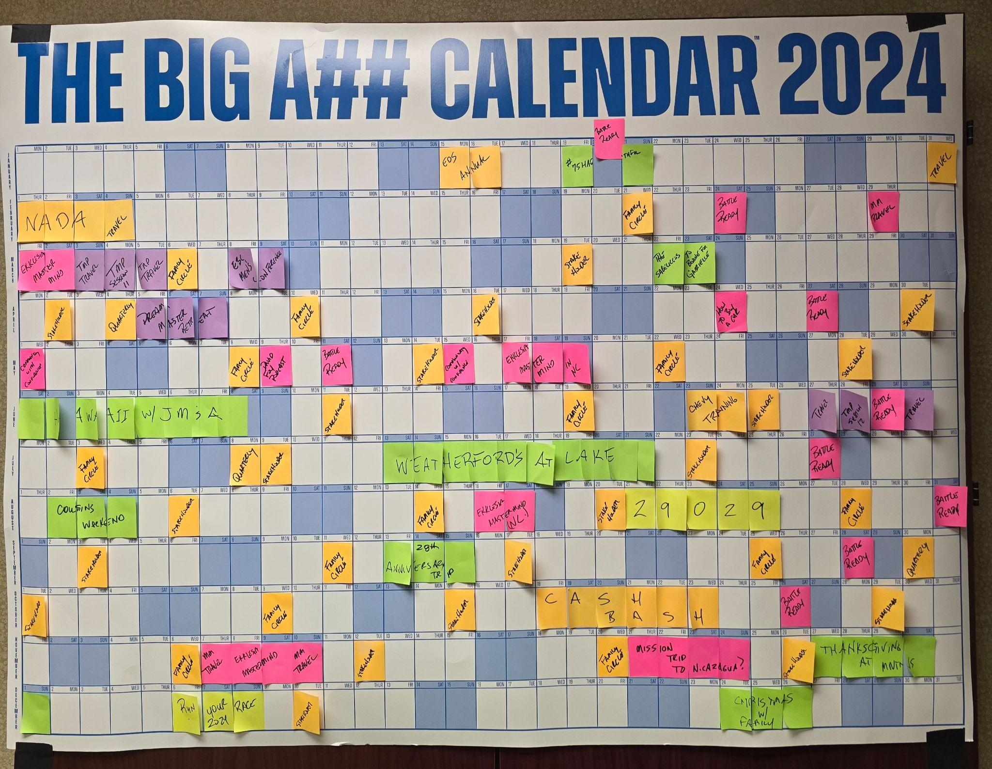

Slide 43
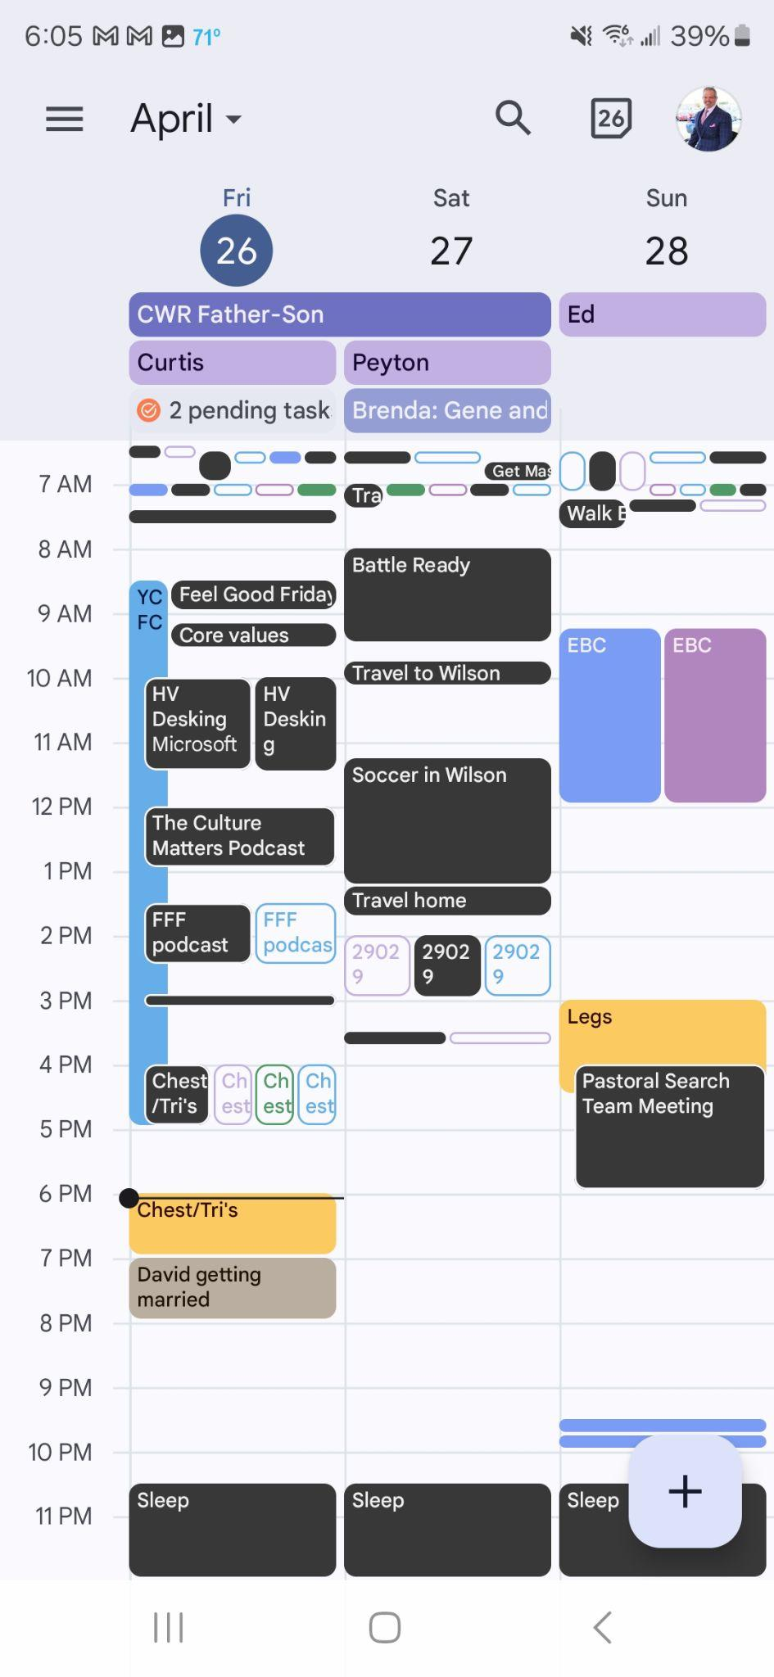
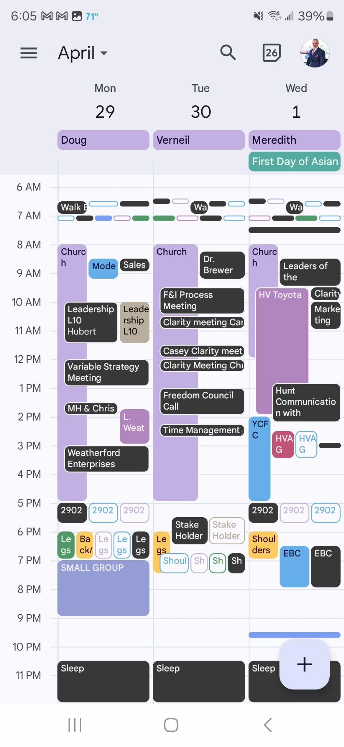
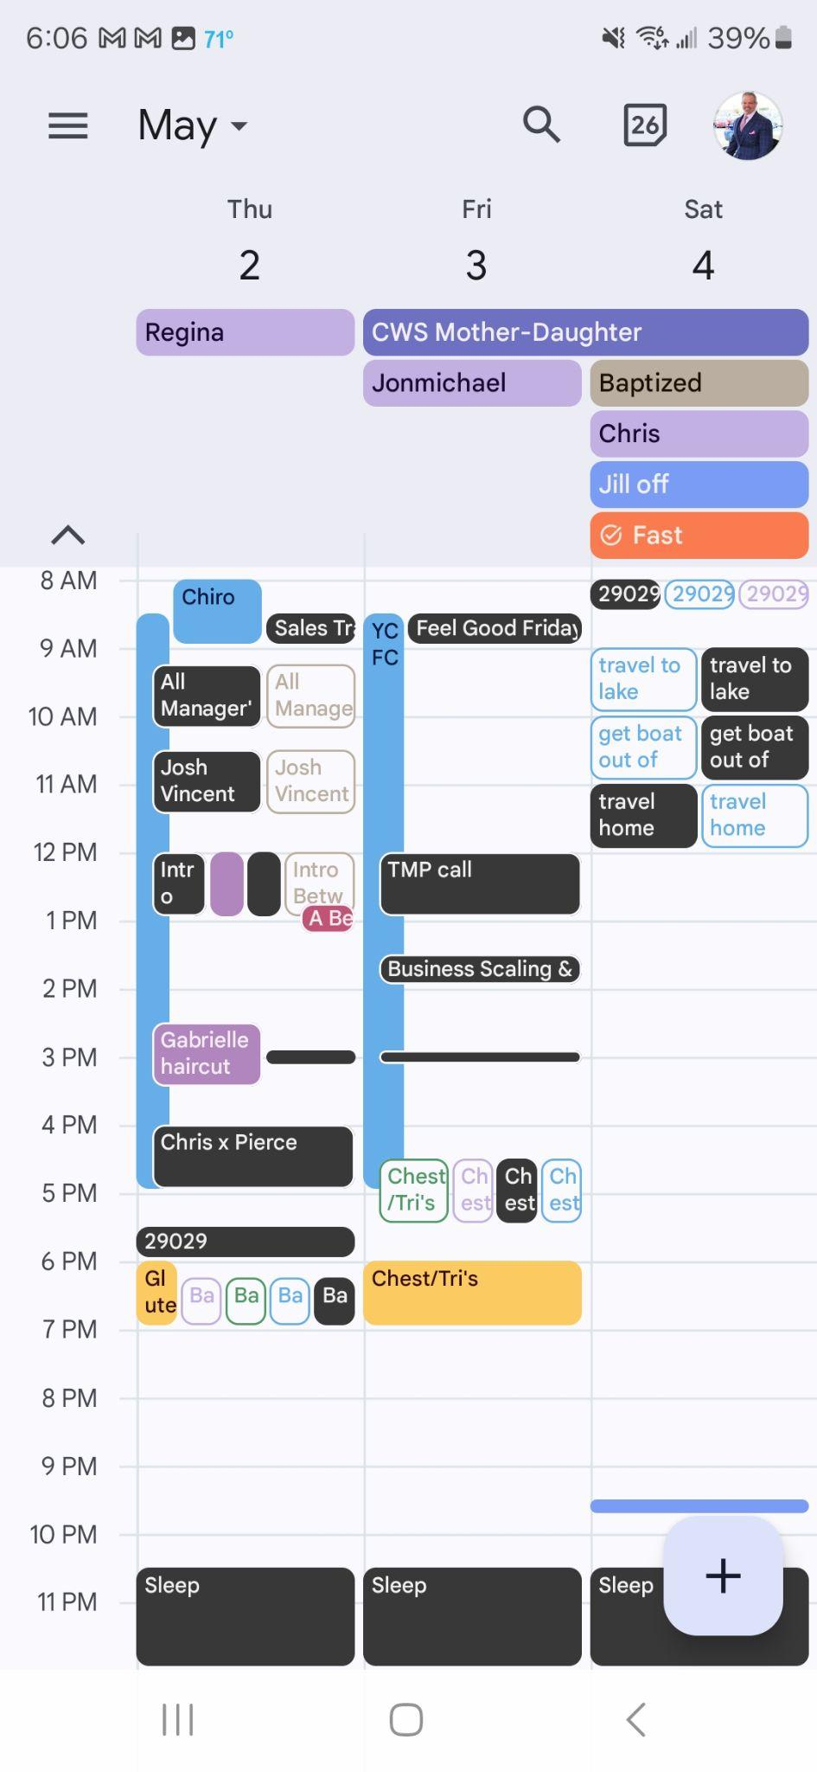

Slide 44
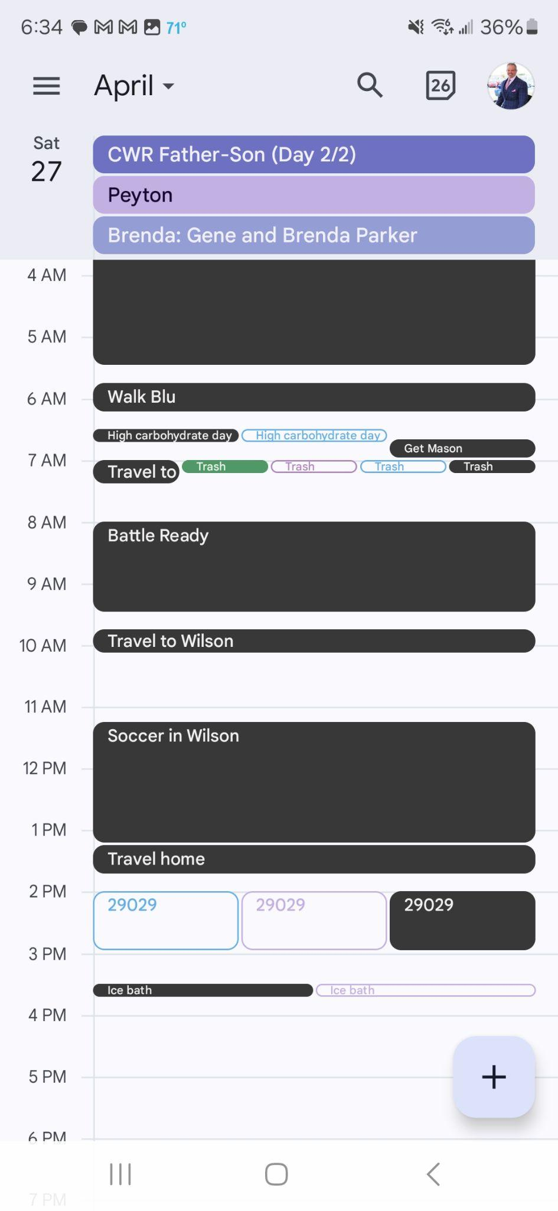
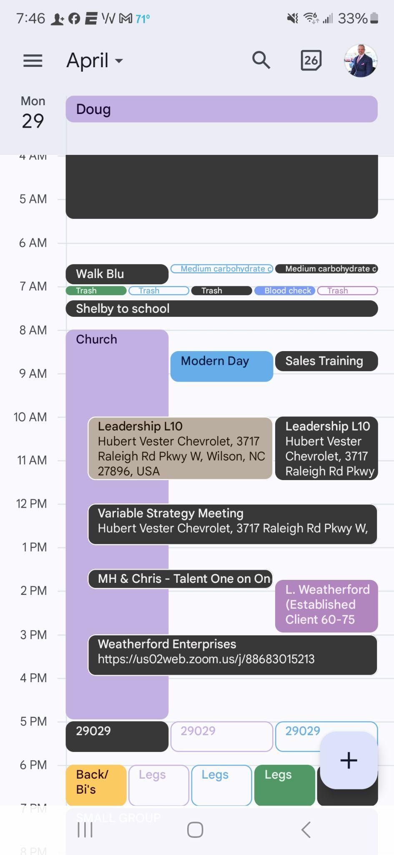
Notes:
If it’s not on your calendar it doesn’t exist. Time blocking based on Focus and Sabbath. White space is buffer.

Slide 45
TIME LEADERSHIP OUTCOMES:
INCREASE LEADERSHIP
(MORE FOCUS DAYS)
DELEGATE MANAGEMENT
(LESS BUFFER DAYS)
EXPERIENCE RESTORATION
(INTACT SABBATH DAYS)
Notes:
Find the best of what you do in the least amount of time so that you have more capacity to go do more of that.
The world judges us based on hours spent, we have to begin to look at the value we create based on what we do with the hours.

Slide 46
CHANGE - NAVIGATING THE SEASONS
Notes:
Change either happens to you or by you
This is about recognizing when change is happening so you are responding to it not reacting to it.
Leaders operate above their circumstances not below them.

Slide 47
There is an time for everything, and a season for
every activity under heaven:
ECCLESIASTES 3:1
Notes:
Life is just a “one and done”...there are seasons to life.

Slide 48
TYPES OF SEASONS:
NATURE
GENERATIONAL
IN RELATIONSHIPS
IN YOUR MARRIAGE
FOR YOUR PRODIGY
IN YOUR CAREER
IN YOUR LIFE MISSION
Notes:
Kids: Caretaker, cop, coach, consultant
2 generations ago workers worked one career in a life time. Current work force today will change career 3-6 times in a life time with multiple seasons in each of those careers.
The mass worldly thought is keep things status quo, predictable and secure
As a leader in Faith, change is your friend
We operate with the creator. All things new, all the time.
Change will be happening BY you and you will be NAVIGATING the change.

Slide 49
SEASON OF DOING
A CHAPTER IN YOUR LIFE
THE RENEWAL
CYCLE
PHASE 2
GO FOR IT
PHASE 3
DOLDRUMS
THE HEROIC YOU
THE DISENCHANTED YOU
MINITRANSITION
PHASE 1
GET READY
PHASE 4
COCOON
A TURNING POINT
A LIFE TRANSITION
SEASON OF BEING
Notes:
This is your “pin drop”
The most unnerving things to leaders is change.
Phase 4 is reinvent
Mini transition is “update and repackage or repurpose”
Time leadership allows you to take a look at this in all 10 commitments
Use this like we did the benchmarks

Slide 50
SIGMOID CURVE
ENDING AND BEGINNING
DOLDRUMS
GO FOR IT
SUCCESS
GET READY
COCOON
TIME
Notes:
Battle ready allows you to use a Biblical worldview to look at your circumstances and decide what's next.

Slide 51
GROUP TIME: MAKE IT PERSONAL
Notes:
You don't know what you don't know until you know. Battle Ready is life by design….

Slide 52
READING SUGGESTION:
“LIFE LAUNCH: A PASSIONATE GUIDE TO THE REST OF YOUR LIFE”
FREDERIC M. HUDSON AND PAMELA D. McCLEAN

Slide 53
www.battlereadyman.com
MAY 25, 2024
“YOUR FAMILY”
JUNE 22, 2024
“YOUR CAREER”

