Slide 1
BATTLE READY
Psalms 144:1

Slide 2
“FAMILY”
Notes:
Last time we came together we talked about time, change and seasons.
If we can understand those seasons we can begin to make things happen with intention. We will use those understandings to help build the house on the foundation of the transformation of our power core and move into the calling to faithfulness in our role as husband and father.
I want to challenge you to look at your marriage for a second. I want to begin with a rhetorical question…..Do you see your bride as an investment that God has made into you?

Slide 3
“HOW TO BE A KINGDOM POWER COUPLE”

Slide 4
KINGDOM LIFE PLANNING
CEILING OF COMPLEXITY
BATTLE READY
INFLECTION POINT
IMPACT OF INFLUENCE
YOUTH ADULT ADULT II
Notes:
Remember in Battle Ready we are building a Kingdom Life Plan. Right now in this moment we are at the Battle Ready Inflection point. The point at which we intentionally make adjustments to increase in influence and blow through the ceiling of complexity
This is where the voices in our head tell us we have done enough, or even that we CAN’T do more.

Slide 5
KINGDOM MARRIAGE PLANNING
CEILING OF COMPLEXITY
BATTLE READY
INFLECTION POINT
IMPACT OF INFLUENCE
MARRIAGE
DATE
YOUTH ADULT ADULT II
Notes:
Whether or not you have a wife now, she has a plot on your life trajectory. That is the point at which your marriage begins to have a trajectory together. That’s the point it becomes more influential and instrumental….
.That influence and instrumentation depends on you and your ability to lead it. Battle Ready prepares us to lead it with Kingdom at the forefront.

Slide 6
YOUR LIFE MISSION
POTENTIAL
PASSION
PURPOSE
Notes:
We have talked about our life missions as men.

Slide 7
POWER COUPLE LIFE MISSION
POTENTIAL
POTENTIAL
PASSION
PURPOSE
PASSION
PURPOSE
Notes:
Now we will examine the life mission of a Kingdom Power couple. The two of you have a life mission. They are different but in parallel they become a power couple. God designed us so that opposites attract….keep that in mind.

Slide 8
AQUILA AND PRISCILLA
PARTNERS IN THE HOME
PARTNERS IN THE MARKETPLACE
PARTNERS IN THE KINGDOM
Notes:
We get a really good example of a power couple in the only couple mentioned in the New Testament.

Slide 9
AQUILA AND PRISCILLA
THEY USED THEIR HOME AND THEIR BUSINESS TO SERVE THE KINGDOM.
Notes:
Let’s look at how the scripture lets us know this.

Slide 10
After this, Paul left Athens and went to Corinth. 2 There he met a Jew named Aquila, a native of Pontus, who had recently come from Italy with his wife Priscilla, because Claudius had ordered all Jews to leave Rome. Paul went to see them, 3 and because he was a tentmaker as they were, he stayed and worked with them. 4 Every Sabbath he reasoned in the synagogue, trying to persuade Jews and Greeks.
ACTS 18:1-4
Notes:
Right off the bat you see Aquila and Priscilla engaged in their home life and work life with someone who is an apostle. That work life gave them the capacity in the Kingdom.

Slide 11
AQUILA AND PRISCILLA
2. THEY EXERCISED THEIR STATUS AS
SELF-DETERMINED FOREPERSONS TO SERVE
KINGDOM PURPOSES.
Notes:
They had freedom in their job to do things in the Kingdom and it gave them the margin to do it.

Slide 12
Paul stayed on in Corinth for some time. Then he left the brothers and sisters and sailed for Syria, accompanied by Priscilla and Aquila. Before he sailed, he had his hair cut off at Cenchreae because of a vow he had taken.
ACTS 18:18
Notes:
Their career gave them freedom to accompany Paul.

Slide 13
AQUILA AND PRISCILLA
3. THEY LEVERAGED THEIR IMPACT BY
STRATEGICALLY INFLUENCING PEOPLE WITH
DEMONSTRATED LEADERSHIP ABILITY.
Notes:
Many power couples, as they get wise (make alot of mistakes) don’t recognize that their wisdom is given to be passed on.

Slide 14
24 Meanwhile a Jew named Apollos, a native of Alexandria, came to Ephesus. He was a learned man, with a thorough knowledge of the Scriptures. 25 He had been instructed in the way of the Lord, and he spoke with great fervor and taught about Jesus accurately, though he knew only the baptism of John. 26 He began to speak boldly in the synagogue. When Priscilla and Aquila heard him, they invited him to their home and explained to him the way of God more adequately.
ACTS 18:24-26
Notes:
Here you see Apollos, who has leadership ability and influence in the Kingdom. Priscilla and Aquila hear him and mentor him in the truth of the Gospel so that HIS influence is more powerful. We know that Apollos went on to be a powerful figure in the early ministry, but what if Priscilla and Aquila had not used their margin, and wisdom in this scenario?

Slide 15
AQUILA AND PRISCILLA
4. THEY WERE COMMITTED TO THE MINISTRY OF
THE LOCAL CHURCH WITH THEIR TIME,
ABILITY AND RESOURCES.

Slide 16
19 The churches in the province of Asia send you greetings. Aquila and Priscilla greet you warmly in the Lord, and so does the church that meets at their house.
1 COR. 16:19
Notes:
Here we see Paul writing to the Corinthians and recognizing that they have a church meeting in their home.
Power couples are CONSTANTLY engaged in the Kingdom moving people forward. They do it together, they use their home, market place and Kingdom Leadership in what they do.

Slide 17
AQUILA AND PRISCILLA
5. THEY WERE GREATER RISK TAKERS IN/FOR
THE KINGDOM THAN THEY WERE IN THE
MARKET PLACE.

Slide 18
3 Greet Priscilla and Aquila, my co-workers in Christ Jesus. 4 They risked their lives for me. Not only I but all the churches of the Gentiles are grateful to them. 5 Greet also the church that meets at their house. Greet my dear friend Epenetus, who was the first convert to Christ in the province of Asia.
ROMANS 6:3-5
Notes:
This lets us know that they had a LARGE amount of influence and they took HEAVY risks.
Looking at all 5 of these factors has caused a great shift in how Suzanne and I approach our life together as a couple.
We have begun to ask ourselves:
Are we using our home and business opportunities to serve the Kingdom?
Are we exercising our status to further Kingdom?
Are we leveraging our impact by influencing people who have demonstrated leadership capability?
Have we committing our time, ability and resources to our local church?
Are we taking bigger risk for the Kingdom than we are in our careers?

Slide 19
“MASTERING YOUR MARRIAGE”
Notes:
For those of you who are not married…..this is when you need to really pay attention….for those of you who ARE married…I’m sorry in advance if your toes are sore when we are done.

Slide 20
STEP 1 IN MARRIAGE:
LOVE YOURSELF LIKE THE TRINITY LOVES YOU.
G0D “LOVE YOUR NEIGHBOUR AS YOURSELF”

Slide 21
STEP 1 IN MARRIAGE:
LOVE YOURSELF LIKE THE TRINITY LOVES YOU.
G0D “LOVE YOUR NEIGHBOUR AS YOURSELF.”
JESUS “LOVE ONE ANOTHER AS I HAVE LOVED YOU.”

Slide 22
STEP #2 IN MARRIAGE:
KNOW THEIR LOVE LANGUAGE AND GIVE IT TO THEM.
1. RECEIVING GIFTS
2. QUALITY TIME
3. WORDS OF AFFIRMATION
4. ACTS OF SERVICE
5. PHYSICAL TOUCH
Notes:
This is one of the biggest steps you can take toward a healthy marriage. German/Spanish If you speak the wrong love language they don’t hear it and you will feel dismissed. These change in seasons (last lesson). As you begin to adopt the practice of using their love languages retest for them after all major life changes.

Slide 23
STEP #3 IN MARRIAGE:
OPPOSITES ATTRACT, EMBRACE IT!!

Slide 24
STEP #4 IN MARRIAGE:
DON’T CHEAT ON YOUR SPOUSE.
Notes:
This seems elementary. Cheating on you spouse does not always involve a woman. There is way more than one way to cheat on your spouse. It can be things, status, opportunities, career, even your children. If you spend more time fulfilling the desires of your children with sports, dance, and other hobbies than you do spending intentional time one on one with your spouse, you are cheating. You are giving your daughters a picture of what being a husband looks like, not just a dad. You are showing your sons how a husband should show up not just a dad. If they don’t see you put your wife second only to God then you are teaching them it’s ok if their future spouse puts them behind their children and they will settle for that as well. Make a time diary and see where you show up in that area.

Slide 25
STEP #5 IN MARRIAGE:
RECONCILIATION: SUPER APOLOGIZE.
“I’M SORRY THAT I _____ TO YOU. I REGRET THAT
IT HAPPENED. I WILL WORK TO AVOID THIS FROM
HAPPENING AGAIN.”
Notes:
IN the MOMENT. Take ownership of the mistake.
Be mindful that everyone has a different method of reconciling.
Give them the permission to call you out when you repeat the offense.

Slide 26
STEP #6 IN MARRIAGE:
FIGHT FAIR.
THE FOUR HORSEMEN:
-CRITICISM
-CONTEMPT
-DEFENSIVENESS
-STONEWALLING
*THE GOAL IS TO TRANSFORM YOUR OWN THINKING NOT HERS.
THEIRS WILL COME IN TIME OR NEVER.
Notes:
Your marriage and how you treat your spouse is direct reflection of your relationship with God.
My default is to try to fix those around me. I had to adjust my thoughts to the one who needs the work is me, and spend intentional time on THAT project. There is enough to deal with when I adopted this thought that I didn’t have time to take inventory of everyone else’s shortcomings. There is a reading list coming and a book that does a great job of digging into this.

Slide 27
STEP #7 IN MARRIAGE:
BE HER SALVATION.
“21 Submit to one another out of reverence for Christ. 22 Wives, submit yourselves to your own husbands as you do to the Lord. 23 For the husband is the head of the wife as Christ is the head of the church, his body, of which he is the Savior. 24 Now as the church submits to Christ, so also wives should submit to their husbands in everything.
Notes:
This may seem like a controversial statement. What does the Bible say?

Slide 28
STEP #7 IN MARRIAGE:
BE HER SALVATION.
25 Husbands, love your wives, just as Christ loved the church and gave himself up for her 26 to make her holy, cleansing her by the washing with water through the word, 27 and to present her to himself as a radiant church, without stain or wrinkle or any other blemish, but holy and blameless. 28 In this same way, husbands ought to love their wives as their own bodies. He who loves his wife loves himself. 29 After all, no one ever hated their own body, but they feed and care for their body, just as Christ does the church— 30 for we are members of his body. 31 “For this reason a man will leave his father and mother and be united to his wife, and the two will become one flesh.”
EPHESIANS 5:21-31
Notes:
This can quickly become a gender battle. This is not what this is about. This tells us this, WE are the thermostat, we set the tone, we set the lead. We have to ask ourselves, am I setting a pace worth following, am I exemplifying the nature of Christ that my family and friends would desire to follow. We can get offended if we want. The bottom line is this….am I worth following, do I have the track record, am I showing Christ to my wife and my kids. BE MEN WORTH FOLLOWING. My family is the greatest masterpiece that can show that Christ has transformed my life.

Slide 29
STEP #7 IN MARRIAGE:
BE HER SALVATION.
“10 If we claim we have not sinned, we make him out to be a liar and his word is not in us.
2 My dear children, I write this to you so that you will not sin. But if anybody does sin, we have an advocate with the Father—Jesus Christ, the Righteous One. 2 He is the atoning sacrifice for our sins, and not only for ours but also for the sins of the whole world.”
1 JOHN 1:10-2:2
Notes:
Does our relationship with our spouse show the difference Jesus has made in our lives? Does it shine the light on our Salvation through faith in Jesus?
The greatest foundational part of our life here on earth is our marriage, the most important priority to the Lord while we are here on Earth is our marriage.
It’s our greatest gift. How are we stewarding that gift?
Remember the first question I asked as we started to discuss being a Power Couple, do you see your bride as an investment God has made in you…..

Slide 30
“INVESTING IN YOUR KIDS”
Notes:
As we move from Power Couple and a mastered marriage the next logical step would be how do we invest in our kids. And this is NOT about money.

Slide 31
STRATEGIC LEADERSHIP FOR THE KIDS GOD GAVE YOU.
Notes:
Kids are not there to be fixtures. Just like your marriage, they are to be an example of your relationship with God. They are gifts that God gave us to be used to instruct us.
God uses several methods to correct and instruct us. He can keep us in a holding pattern until we learn the lesson, he can place people in our lives that lead and instruct us as well.

Slide 32
3 1 This saying is trustworthy: “If anyone aspires to be an overseer, he desires a noble work.” 2 An overseer, therefore, must be above reproach, the husband of one wife, self-controlled, sensible, respectable, hospitable, able to teach, 3 not an excessive drinker, not a bully but gentle, not quarrelsome, not greedy. 4 He must manage his own household competently and have his children under control with all dignity. 5 (If anyone does not know how to manage his own household, how will he take care of God’s church?)
1 TIMOTHY 3:1-5
Notes:
Most of the time when we examine this passage we dismiss it to be about Pastors or Deacons. We are overseers of the first institution that God created, FAMILY.
Basically, Is our house in order? Can we manage the ministry of our home, our marriage and our children? We must be able to do this before we can even begin to change the world. We default to going and crushing it in the world and our family gets the crumbs.
”If I am the great provider and bring home the bacon, everyone is happy.” THAT is being ruled by mana and money.
We must put family first. Fear causes us to leapfrog to being a provider.

Slide 33
THE CHOICE TO OUTSOURCE AUTHORITY
CHURCH. YOUTH GROUP. WIFE
Notes:
Most believe they can outsource their biblical outlook for their kids…. Church will teach them. They have a great youth group/youth pastor. My wife is better at that……..We’ll put them in a Christian School….
You are in the drivers seat of your kids legacy. You are responsible for establishing a biblical world view.
It’s not about what they are taught in any of those places.
It’s about what is caught by witnessing you operate in your marriage and under biblical standards.

Slide 34
6 These words that I am giving you today are to be in your heart. 7 Repeat them to your children. Talk about them when you sit in your house and when you walk along the road, when you lie down and when you get up. 8 Bind them as a sign on your hand and let them be a symbol on your forehead. 9 Write them on the doorposts of your house and on your city gates.
DEUTERONOMY 6:6-9
Notes:
Are you doing Bible study with your family? The benefit of The Gospel Project…. Daily conversations or at least conversations for the ride to and from church.

Slide 35
ACTIVE PARENTING FOR
ETERNAL SIGNIFICANCE
THE CURRICULAR DIMENSION
THE EXTRA-CURRICULAR DIMENSION
Notes:
The curricular dimension is this, Battle Ready. How can we begin to introduce our children to the ideas, language and training to create a next generation of Battle Ready?

Slide 36
TEACH THEM THE SIGNIFICANCE OF BEING BATTLE READY AND DEVELOPING A LIFE MISSION.
BALANCE / MARGIN / FOCUS
KINGDOM REALM
SPOUSE
CHILDREN
TIME
SPENT
POTENTIAL
BODY
MIND
CAREER
SPIRIT
RESOURCES
SOUL
PASSION
PURPOSE
20%
80%
TIME
INVESTED
Efforts
RESULTS
THE WORLD
STRATEGIC THEMES
Notes:
Use Battle Ready to develop their world view. How many kids do you know that are being exposed to what you have been exposed to over the last 5 months.

Slide 37
YOUR PARENTING CURRICULUM:
WHAT’S YOUR DREAM?
WHAT NURTURE WILL THEY REQUIRE?
WHAT ADMONITION WILL THEY NEED?
THEN,
WHAT BOOKS COULD YOU READ?
WHAT EXPERIENCES COULD YOU SHARE?
WHAT PEOPLE COULD YOU INVOLVE?

Slide 38
RECORDED COMMUNICATIONS
Notes:
Letters,
Little girls want to know they have something to offer and men want to know they have what it takes.
“My Life” journaling, Date Night recaps saved to give insight into marriage, Video Blogs,
It’s about active and intentional pursuit of them.

Slide 39
THE EXTRACURRICULAR DIMENSION
Notes:
The extra- curricular dimension is powerful. We call them BEST DAYS.
Take each kid, on their own, and ask “If you could do anything you want, anywhere in the world for one day what would it be?
Then make it happen.
They have you undivided, but you have them undivided as well.
Use this time to begin showing and teaching Battle Ready life by design.
We need to change our thinking from how have we increased our bank account or other measure of success to 1)How much faith have you increased THEN how much relational equity have you increase in your wife and your kids.

Slide 40
EXTRAORDINARY APPROACH TO TIME…
12
SABBATH
9
FOCUS
3
BUFFER
TIME LEADERSHIP
6
Notes:
How do you do all that? You have to have an extraordinary approach to time. Your family is your #1 client. They get time on your calendar. They get FOCUS time on your calendar.

Slide 41
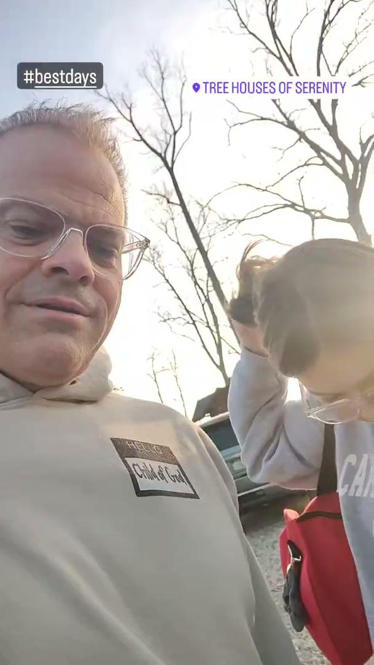

Slide 42
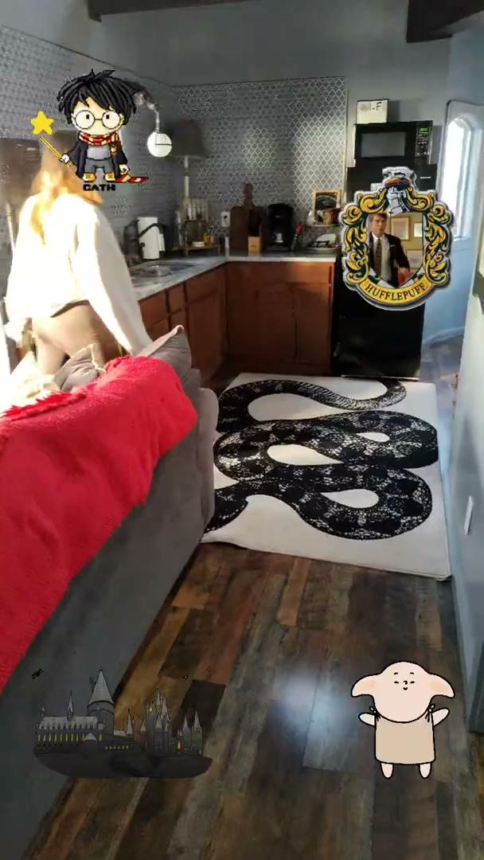

Slide 44
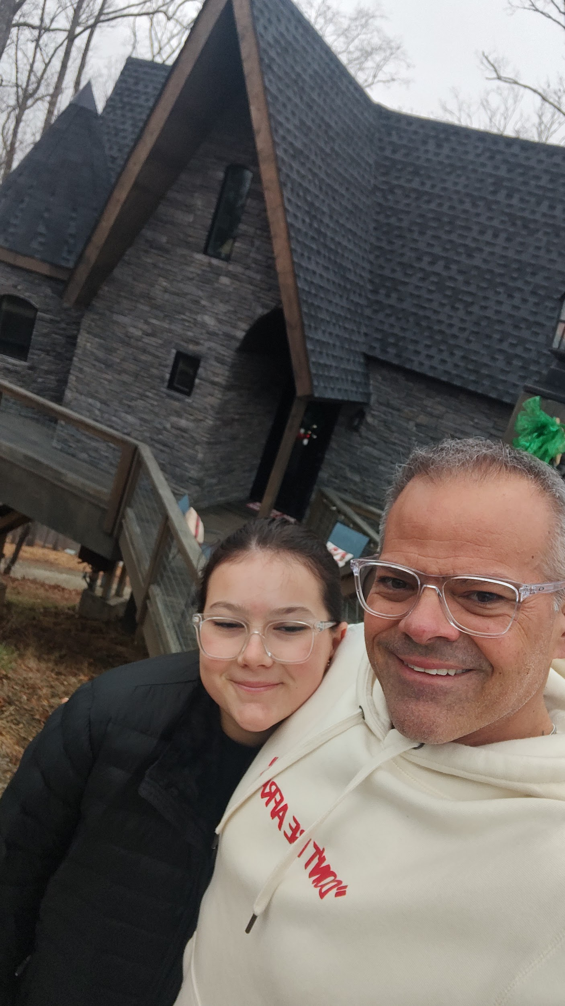
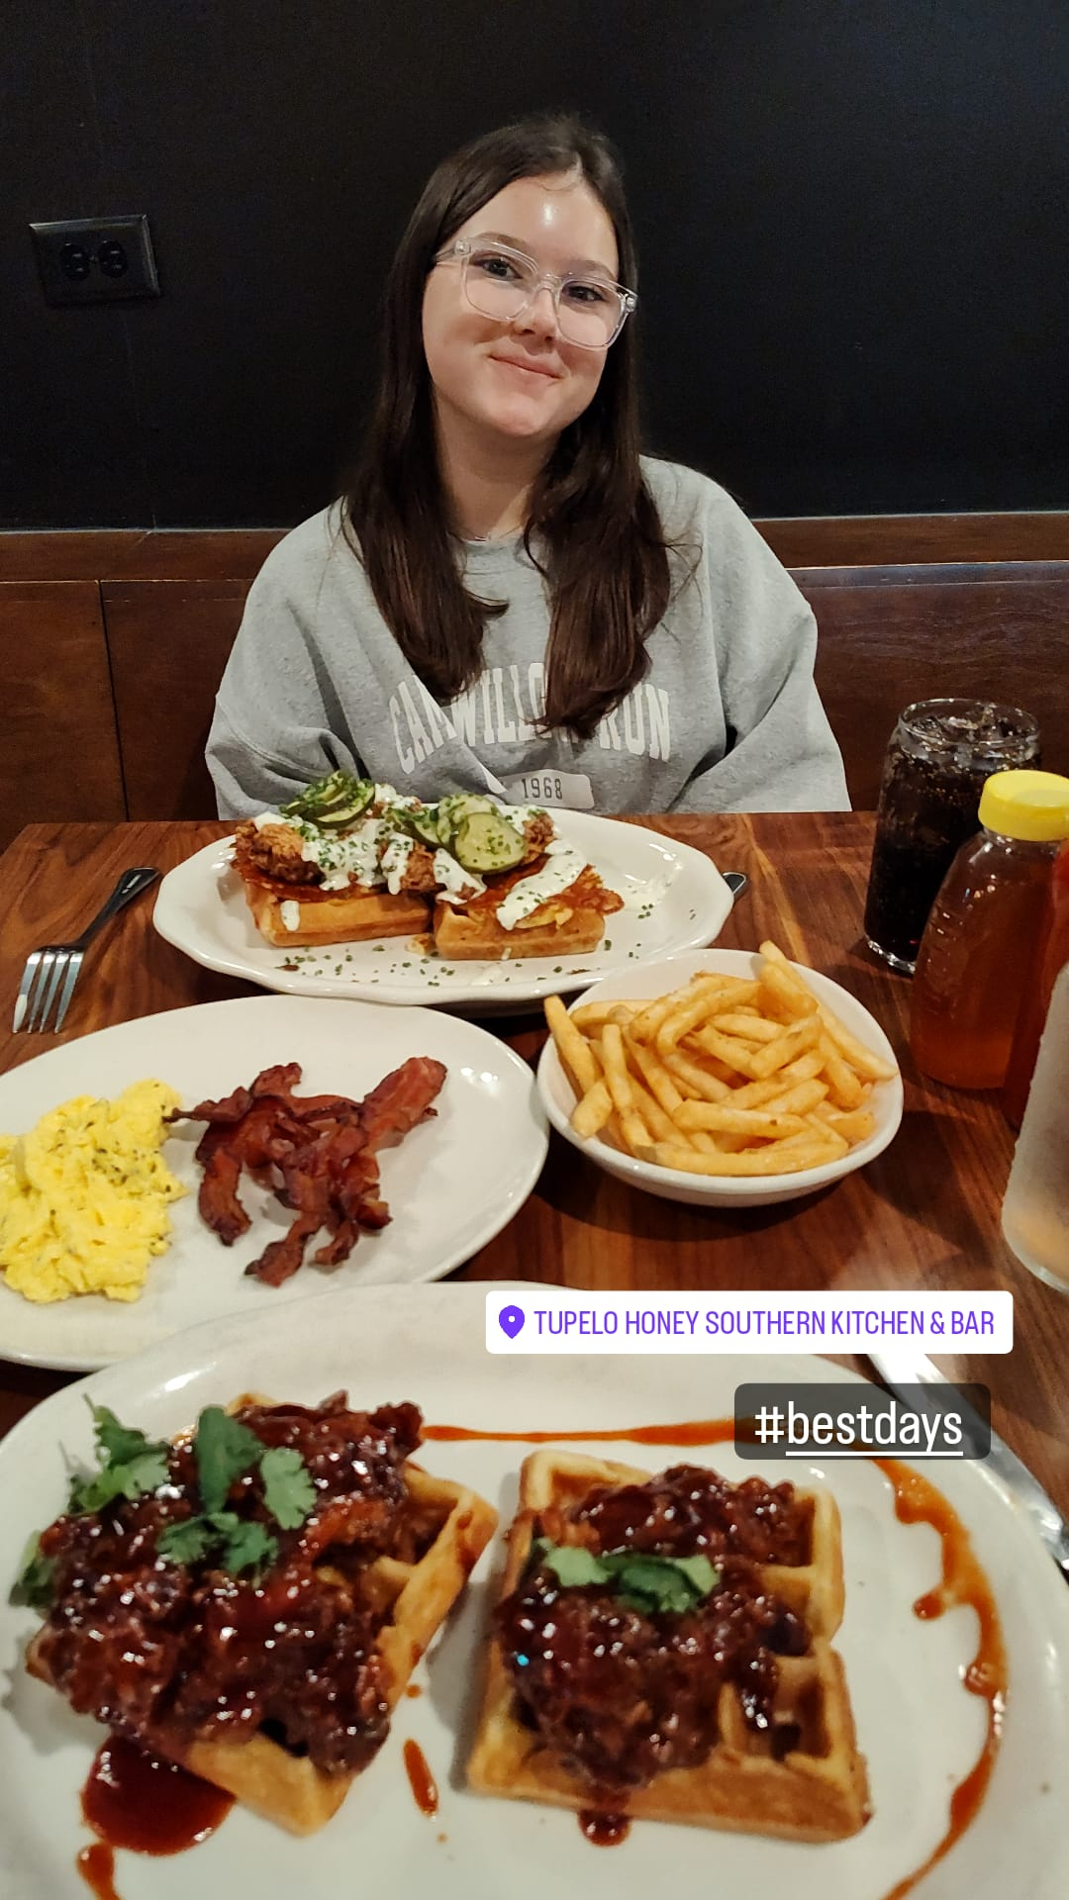
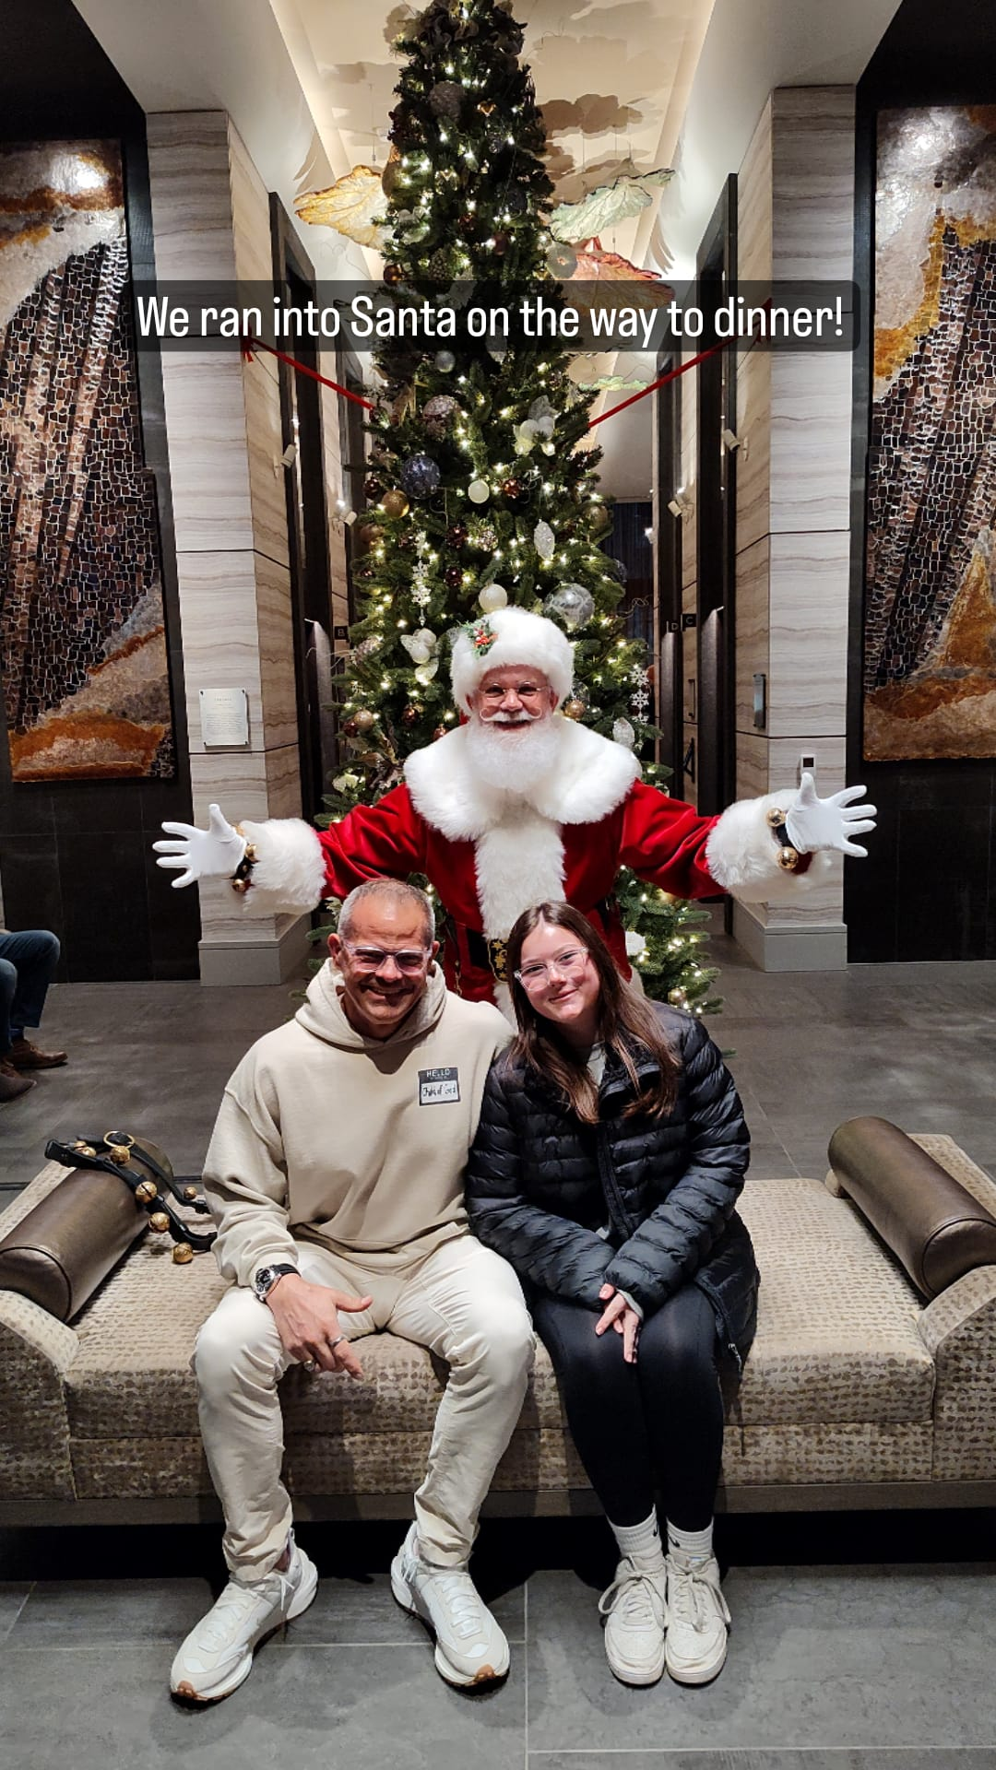
Notes:
This not about money spent. This is about them knowing they have you completely undivided. . It’s carved out by design…FOCUS TIME. Best thing you can hear when you ask them about their next best day…..”didn’t we just have one?”

Slide 45
DREAM MASTER
Notes:
God is calling us to BATTLE READY. The pathway is through honoring our commitments to our spouse and our kids. The investments we make pay huge dividends and they actually pull us into BATTLE READY. Those investments help us create the desire to build up our power core.
Dream Master is about finding the imagination space to create in all areas and we do that WITH our spouse.

Slide 46
11 In view of this, we always pray for you that our God will make you worthy of his calling, and by his power fulfill your every desire to do good and your work produced by faith, 12 so that the name of our Lord Jesus will be glorified by you, and you by him, according to the grace of our God and the Lord Jesus Christ.
2 THESSALONIANS 1:11-12
Notes:
There are things that God is going to prompt us to fulfill our desires that align with his desires. God is interested in our dreams. Our responsibility is to guard our imaginations. It becomes proof of leadership.

Slide 47
“EVERYTHING IS BUILT TWICE. FIRST IN THE MIND, THEN IN REALITY”
STEPHEN COVEY
Notes:
First in the mind then BROUGHT FORTH into the world. What is your imagination and how is it used in Kingdom purposes? Many people say their imagination is at fault for giving a space for the enemy to take them to dark spaces. If you cultivate that poor imagination you will bring forth that dark space. The converse is also true. If you cultivate brilliant imaginations, KINGDOM imaginations based on your FAITH you with bring forth those KINGDOM initiatives.

Slide 48
GUARDING YOUR IMAGINATION BECOMES PROOF OF LEADERSHIP.

Slide 49
PROOF OF LEADERSHIP
DREAMS EXPERIENCED
FAMILY
Notes:
Dream Master is a tool to call forth those imaginations. First in the Family Realm. In this realm we want dreams to be experienced. We’ve talked about ways to become a power couple and dreams to be experienced there and dreams for best days with our kids.

Slide 50
PROOF OF LEADERSHIP
DREAMS EXPERIENCED
INITIATIVES ACHIEVED
FAMILY > PROFESSIONAL
Notes:
Then in the professional realm we want initiatives achieved in our career and our resources.

Slide 51
PROOF OF LEADERSHIP
DREAMS EXPERIENCED
INITIATIVES ACHIEVED
VISION ACCOMPLISHED
FAMILY > PROFESSIONAL > KINGDOM
Notes:
Finally in Kingdom it’s about Vision accomplished.
What is that vision that Jesus has placed on your heart.
We have to invest time in the imagination space to vision out what can be accomplished.
What is interesting about life there is so much capacity for dreams. And if done correctly we get to live our those dreams. But, if we don’t create it first in our imaginations AND put the plan on paper we never get to live out those dreams.
When people are asked about their death date and the year preceding it about what that looks like. Ie what have you accomplished, what is your personal health, what is your mindset, what does your marriage look like, what is the relationship with your kids…. they would paint the perfect picture.
THIS is what Dream Master can help accomplish.

Slide 52
The Price of Success: Your Your Dreams Retire Before You Do!
DREAMS
Achievements Materialize;
Impact of Influence
Ceiling of Complexity
SUCCESS
Dreams
Disappear!
youth adult I adult II
Notes:
The funny thing about dreams is as life goes and and we experience success our dreams die.
As children we had huge dreams, then as we ACCOMPLISH, instead of cultivating more dream space they die and dissapear.
Dream Master is about turning that upside down and continuing to dream bigger as we accomplish our dreams, in particular in the Kingdom space that God is bringing to you.

Slide 53
DREAM TYPES:
FOR YOUR MARRIAGE
FOR YOUR KIDS
FOR YOUR CAREER
FOR YOUR FINANCES
FOR YOUR LIFE MISSION
Notes:
Dream Master is about developing dreams in the 5 specific areas of life.
You do this WITH your wife.
Take time away specifically to do this. You develop them separately and then come together to find those that you share, and those that are special to you.
This is in conjunction with what is God saying to you about them. You then begin focusing on those and charting the course to bring them to life.

Slide 54
HOW DOES DREAM MASTER WORK?
DREAMSTORMING
DREAMSTAGING
DREAMLINKING
DREAMSCHEMING
DREAMTEAMING
Notes:
Scheming is when you begin acting on the course you have plotted.
It’s not you and your dream against the world, there will be strategic partners who come along in God’s timing.
Teaming is about searching your current circle of influence to see if you already see those possible partnerships.
Proof of leadership is having a dream and being able to cast it in a Kingdom way and put it in to practice. God will deliver more than you can ever ask, think or imagine. Use this time to TRY and out dream him.

Slide 55
SETTING ASIDE TIME TO DREAM…
…FOCUS DAYS REQUIRED.
12
SABBATH
9
FOCUS
3
BUFFER
6
Notes:
We are going to have to use Focus time and SET ASIDE Focus time. It HAS to be on the calendar, if it’s not on the calendar it doesn’t exist. What is the day this year that you are going to set aside for Dream Master?

Slide 56
AROUND THE TABLE TIME

Slide 57
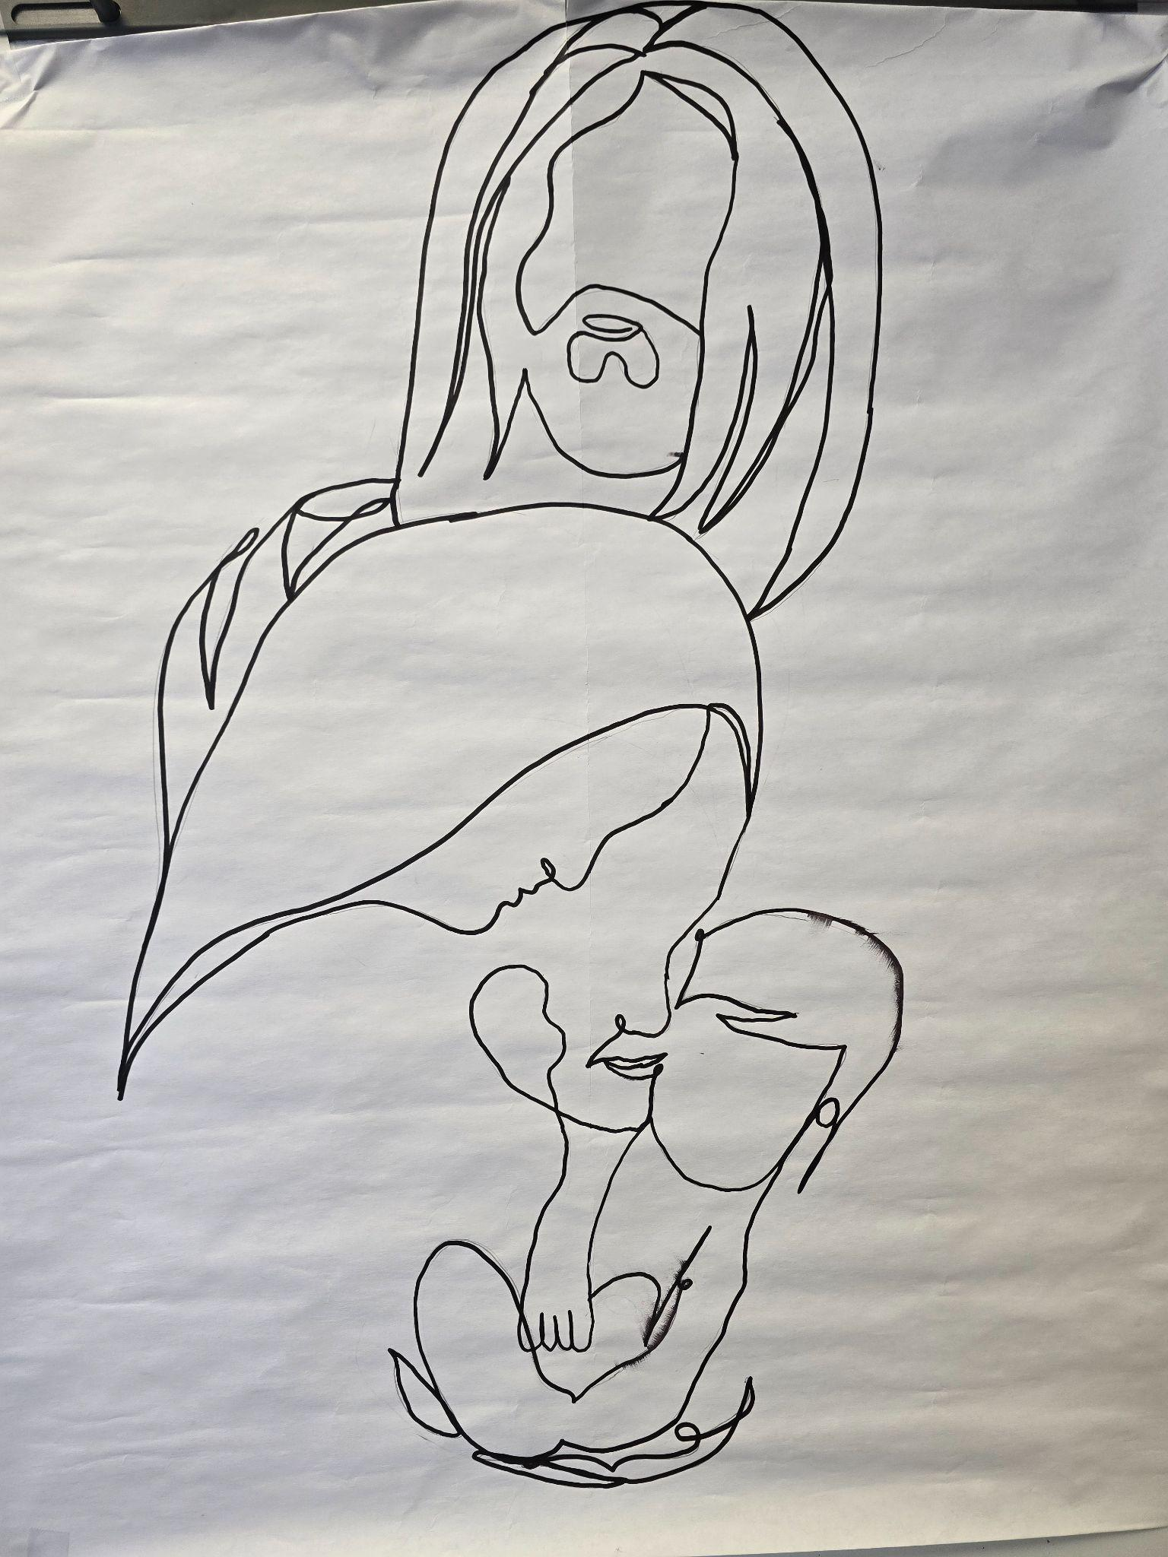

Slide 58
READING RESOURCES:
“The Seven Principles of Making Marriage Work”
John M. Gottman PhD.
“Dream Giver: Following your God-Given Destiny”
Bruce Wilkinson
“Revolutionary Parenting: Raising Your Kids to Become
Spiritual Champions”
George Barna
“You and Me FOREVER: Marriage in Light of Eternity”
Francis and Lisa Chan

Slide 59
www.battlereadyman.com
June 22 “Your Career”
July 27 “Your Resources”

