Slide 1
BATTLE READY
Psalms 144:1
Notes:
I hope at this point you are beginning to see how each of these sessions build upon the last. We left off last time with Dream Master. I shared with you the impact of that as well as Best Days with my own family. I hope you have implemented your schedule in the coming months. As I stated, Suzanne and I plan on hosting Dream Master Days in our home later in the year if that is something you think you will be interested in.

Slide 2
“YOUR CAREER”
Notes:
Today we shift into your career. Your career is where you give most of your focus and for most it’s what consumes most of your time. Even to the detriment of other areas of our lives.

Slide 3
YOUR CAREER AND THE KINGDOM
Notes:
Today is about thinking our career and it’s relevance in the Kingdom and what that looks like.

Slide 4
KEY QUESTION:
WHAT IS THE HIGH-CALL OF GOD?
Notes:
The best question to start this journey is this. When most of us think about this we immediately go to the ones in the pulpit or on the mission field.

Slide 5
WHAT IS THE HIGH-CALL OF GOD?
BATTLE READY:
TO MAXIMIZE THE RETURN ON
WHAT GOD HAS INVESTED IN YOU,
BELIEVING THAT HE WILL DO THE
MIRACULOUS THROUGH YOU.
Notes:
In Battle Ready the high call of God is this:
When we think about our career, it is the exchange or talent we give for money. What we are exchanging God’s investment in US. It is our time, talent, and our influence. They are being expended in our career.
So what we are going to look at is what the Kingdom aspect of that investment in us might look like.

Slide 6
CAREER MINDSET
SECULAR
NO SPIRITUAL SIGNIFICANCE
BATTLE READY
CAREER = CALLING
SPIRITUAL SIGNIFICANCE
Notes:
In Battle Ready there are two extremes that people in the church think of. It’s either the marketplace leader which is completely secular not spiritual at all or at least no spiritually significant. Or we think about career as calling maybe a minister or pastor where EVERYTHING is spiritual.
Battle Ready is SOLELY in the middle. It’s realizing that there are marketplace things and there are Kingdom things and all are Spiritually relevant. It’s about turning thinking upside down and realizing that being a Jesus follower is not a one day a week experience followed by six days in the marketplace. Kingdom is a seven day a week experience where things are happening with your time talent and treasure.

Slide 7
GOD COMMANDS PRODUCTIVE EFFORT OVER SELF-SERVING LEISURE AS A WAY OF LIFE.
6 Brothers and sisters, we command you in the name of our Lord Jesus Christ to stay away from every brother or sister who lives an undisciplined life that is not in line with the traditions that you received from us…10 Even when we were with you we were giving you this command: “If anyone doesn’t want to work, they shouldn’t eat.”
2 THESSALONIANS 3:6-10
Notes:
God commands work. We are put on this planet to use our talent. Work is use of that talent in exchange for money. Before there was money it was shoeing horses in exchange for food or sharpening our farming tools in exchange for eggs.
Money is the manifestation of our talent. And God calls us to work.

Slide 8
2. CAREER ACTIVITIES PRODUCE THE FINANCIAL CAPACITY
TO FUND YOUR OWN RESPONSIBILITIES, AS WELL AS
MINISTRY SERVICES THAT EXTEND THE KINGDOM.
34 You yourselves know that I have provided for my own needs and for those of my companions with my own hands. 35 In everything I have shown you that, by working hard, we must help the weak. In this way we remember the Lord Jesus’ words: ‘It is more blessed to give than to receive.’”
ACTS 20:34-35
Notes:
The fact is our capacity to work and earn money helps other people. We are helping in our contribution in the marketplace and we are helping when we take the money we earn from this contribution and give it.
Interesting to note, the words of Jesus here are not found in the Gospel. They appeal to our selfish nature letting us know that will be more blessed in our giving than in our selfish receiving. And this giving begins in the marketplace.

Slide 9
3. PROFESSIONAL ACTIVITIES PROVIDE OPPORTUNITIES TO ENHANCE GOD’S IMAGE THROUGH YOUR SUPERIOR EFFORTS.
23 Whatever you do, do it from the heart for the Lord and not for people.
COLOSSIANS 3:23
Notes:
This means regardless of how menial the task it is for the Lord and we should perform it as if. This is how Jesus followers set themselves apart for the glory of the Lord in the marketplace.

Slide 10
LIFETIME PURSUIT: CAREER & CALLING
CLERGY (TRADITIONAL)
LIFETIME —-->LIFETIME —-->LIFETIME —-->LIFETIME —-->
CHILDHOOD CAREER CALLING
Notes:
When we look at calling in career how does the bible give us examples?

Slide 11
LIFETIME PURSUIT: CAREER & CALLING
LAYMEN (TRADITIONAL)
CLERGY (TRADITIONAL)
LIFETIME —-->LIFETIME —-->LIFETIME —-->LIFETIME —-->
CHILDHOOD CAREER CALLING

Slide 12
LIFETIME PURSUIT: CAREER & CALLING
JESUS (BIBLICAL)
LAYMEN (TRADITIONAL)
CLERGY (TRADITIONAL)
LIFETIME —-->LIFETIME —-->LIFETIME —-->LIFETIME —-->
CHILDHOOD CAREER CALLING
Notes:
A carpenter for AT LEAST a decade before his calling.

Slide 13
LIFETIME PURSUIT: CAREER & CALLING
PETER (BIBLICAL)
JESUS (BIBLICAL)
LAYMEN (TRADITIONAL)
CLERGY (TRADITIONAL)
LIFETIME —-->LIFETIME —-->LIFETIME —-->LIFETIME —-->
CHILDHOOD CAREER CALLING

Slide 14
LIFETIME PURSUIT: CAREER & CALLING
PAUL (BIBLICAL)
PETER (BIBLICAL)
JESUS (BIBLICAL)
LAYMEN (TRADITIONAL)
CLERGY (TRADITIONAL)
LIFETIME —-->LIFETIME —-->LIFETIME —-->LIFETIME —-->
CHILDHOOD CAREER CALLING
Notes:
Tentmaking, tentmaking while he began his calling, then completely in his calling.

Slide 15
LIFETIME PURSUIT: CAREER & CALLING
REFINE CAREER;
PREPARE FOR CALLING
CEILING OF COMPLEXITY
PAUL (BIBLICAL)
IMPACT OF INFLUENCE
PETER (BIBLICAL)
JESUS (BIBLICAL)
YOUTH ADULT ADULT II
Notes:
We have to reimagine how our career can work for us when it comes to our calling. This isn’t about shifting careers it’s about shifting how you look at your career. How can we use our career to create margin that allows us to operate in our calling.

Slide 16
BATTLE READY PROGRAM CAREER TERMS:
BE MOTIVATED BY GOD HONORING PASSION
REFINE TO PERFORM ONLY TASKS THAT USE YOUR GOD-DESIGNED UNIQUENESS
WORK LESS, MAKE MORE MONEY
INCREASE DISCRETIONARY TIME

Slide 17
CRITICAL QUESTION…
HOW IS GOD’S GLORY AND KINGDOM PURPOSE BEING SERVED TODAY THROUGH YOUR CAREER?
Notes:
When we begin to study the parallels between career and Kingdom we have to ask ourselves “Where is God showing up at work”, “what does he love about what I am doing in my current career”

Slide 18
CRITICAL QUESTION…
PAUL’S
WORKSHEET
IT ALLOWS ME A TREMENDOUS AMOUNT OF MOBILITY; I’M ABLE TO MOVE FROM CITY TO CITY WITHOUT BEING TOO “TIED DOWN” BY MY WORK.
MY JOB DOESN’T DEMAND MY FULL INTELLECTUAL CAPACITIES, SO I HAVE TIME TO THINK ABOUT MY CALLING WHILE I’M WORKING.
I’VE BEEN ABLE TO PARTNER WITH OTHER BELIEVERS (AQUILA AND PRISCILLA) SO I DIDN’T HAVE TO CARRY THE ENTIRE LOAD ALONE.
MY INCOME STREAM HAS BEEN ADEQUATE TO PAY FOR MY OWN PERSONAL EXPENSES WHILE I DO MY CALLING “FREE OF CHARGE”.
I MAKE ENOUGH MONEY TO SUPPORT THE TEAM WHO SUPPORT MY OWN CALLING; NO FUNDRAISING IS NECESSARY FOR THE MINISTRY.
Notes:
This is part of the packet discussion.

Slide 19
THE 80/20 PRINCIPLE
Notes:
So you are probably asking…..just how does this happen practically. The 80/20 principle is truly the secret sauce to finding margin.

Slide 20
FORMULA FOR SUCCESS
STRATEGIC BEHAVIOR
+ TIME
SIGNIFICANT OUTCOMES

Slide 21
WHAT
YOU
BRING
NOTHING
SKILLS
KNOWLEDGE
NATURAL TALENT
GENIUS
EXCELLENCE
COMPETENCE
INCOMPETENCE
WHAT
YOU
PRODUCE
Notes:
Where your natural talent and genius align is where you find yourself saying “I can’t believe I get paid for this”
As you move away from the center you become less and less valuable and useful producing less yield for the effort and the time. The idea is to operate in your natural talent and genius.

Slide 22
THE 80/20
PRINCIPLE
TIME
SPENT
MOST RESULTS COME FROM A SMALL SAMPLING OF THE EXPENDED EFFORTS.
TIME INVESTED
20%
80%
EFFORTS RESULTS
Notes:
If you look at your normal day and from the time your feet hit the ground until you lay your head down you are packed with ZERO down time you are maxed…..but what is causing the max out? Take a step back and take a look at how to take a machete to the activities that are not producing results.

Slide 23
THE 80/20
PRINCIPLE
ELIMINATE
IMMEDIATELY
ERADICATE
SYSTEMATICALLY
MULTIPLY
STRATEGICALLY
TIME
SPENT
TIME INVESTED
80%
20%
EFFORTS RESULTS
Notes:
Anything in red has to be eliminated immediately. Some would say “why not knock out everything that isn’t the highest producing time investment?”
If you take inventory of the things you do that produce any real result and can see things that can be kept in your wheelhouse but delegated or brokered for a positive result you should keep it.

Slide 24
THE 80/20
PRINCIPLE
MARGIN
MARGIN
ERADICATE
SYSTEMATICALLY
MULTIPLY
STRATEGICALLY
EFFORTS RESULTS
Notes:
When you do this the 20% get really concentrated and brings larger and larger results and returns. It’s not about maxing out the thermometer again, it’s about strategically mastering your time.

Slide 25
THE 80/20
PRINCIPLE
MARGIN
MARGIN
CALLING FOCUS DAYS
LOW RETURN
BUFFER DAYS
HIGH RETURN
CAREER FOCUS DAYS
EFFORTS RESULTS
Notes:
Again what does that look like?
New found margin is for CALLING focus days
Buffer days are where we find activities that could potentially be delegated or brokered
And at work you are WAY more productive. The time that is being spent is FOCUSED CAREER time that is yielding Massivie results, because you are not running at redline and you are in your genius and natural talent.
Better quality work, better creativity, less stress, less anxiety, you know who you are and what you offer and you offer it well.

Slide 26
THE 80/20
PRINCIPLE
SABBATH
MARGIN
CALLING FOCUS DAYS
LOW RETURN
BUFFER DAYS
HIGH RETURN
CAREER FOCUS DAYS
FOCUS
BUFFER

Slide 27
THE 80/20 PRINCIPLE
CAREER
MARGIN
EFFORTS RESULTS
Notes:
We tak the new found margin and move it ALONG SIDE you career for you calling.

Slide 28
THE 80/20 PRINCIPLE
CAREER
CALLING
MARGIN
EFFORTS RESULTS
EFFORTS RESULTS
Notes:
This doesn’t necessarily mean it is separate from your career. It could be inside of your career. You will take the time to work through this in the worksheets at the table by Rate your use for each of your responsibilities. Label as “Incompetent/
weak”, “Competent/ok”, “Excellent/good,” or “Natural talent/strong”)

Slide 29
“YOUR GOD-DESIGNED POTENTIAL”

Slide 30
DISCOVERING THE MASTERPIECE:
POTENTIAL
Notes:
How many in here thought of yourself when I asked the question?

Slide 31
DISCOVERING THE MASTERPIECE: YOU
10 Instead, we are God’s workmanship, created in Christ Jesus to do good things. God planned for these good things to be the way that we live our lives.
EPHESIANS 2:10
POTENTIAL
Notes:
Workmanship in Greek is Poema = poem. We were created before time existed, the trinity was together thinking about what YOU would do, giving you the capability to do the things he designed you to do and preparing the work specifically designed for you to do. They not only gave you the perfect design but also the opportunity to use that designfor God’s glory and purpose.
God, Jesus and Holy Spirit are giving us work and also they are gifting us especially for that work. We don’t see ourselves as God’s masterpiece. We tend to play down or shame the masterpiece.

Slide 32
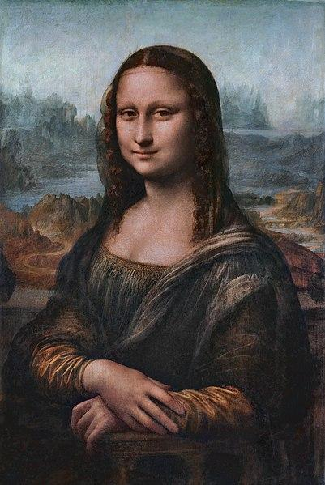
POTENTIAL
Notes:
It’s doesn’t measure up. Not a gift. Has flaws.
Awkward and strange with the artist in the room. We do that all the time by discounting what God created when he created us. How do we begin to see ourselves and what gifts we are equipped with?

Slide 33
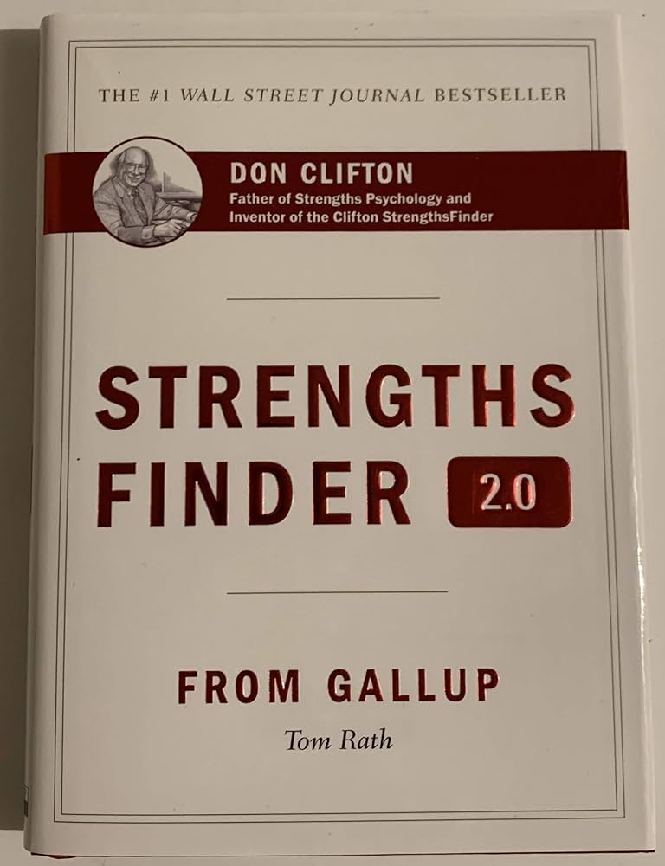
YOUR NATURAL TALENTS
POTENTIAL
“STRENGTH FINDER 2.0”
BY: TOM RATH
Notes:
They have discovered 34 Natural talents separated by themes. For example communication is a theme and inside of that theme is any talent that revolves around communicating. By taking the assessment you are shown your top five talent themes. Talents that God specifically gave only to you.

Slide 34
YOUR NATURAL TALENTS
POTENTIAL
MY TOP FIVE
NATURAL
TALLENTS

Slide 35
YOUR NATURAL TALENTS
POTENTIAL
MY TOP FIVE
NATURAL
TALLENTS
FUTURISTIC
STRATEGIC
ACTIVATOR
LEARNER
IDEATION
Notes:
These are the ones that came back for me.

Slide 36
YOUR NATURAL TALENTS
POTENTIAL
TIME
SPENT
YOUR NATURAL TALENTS ARE ALSO YOUR BEST TIME INVESTMENT
FUTURISTIC
STRATEGIC
ACTIVATOR
LEARNER
IDEATION
TIME INVESTED
EFFORTS RESULTS
Notes:
If you are going to get blown up results it’s going to take focusing on those talents. Then..
Celebrate it
Own it
Aim it

Slide 37
YOUR NATURAL TALENTS
POTENTIAL
NAME IT: DEFINE OUR NATURAL TALENTS.
CLAIM IT: REALLY UNDERSTAND AND OWN THEM.
AIM IT: REPEATEDLY CHOOSE ACTIVITIES THAT USE OUR TALENTS.
Notes:
The book gives you the names and the definitions of each of your talent themes. When you define them you are going to have to own them and get really familiar with them even memorize them. THEN AIM them by focusing on activities that USE those.
If you train on your talents you will experience MORE RAPID growth than if you trained on your weaknesses. It’s counterintuitive, we think we should train on what we need work on. God designed us to focus on our talents. “Around the table.

Slide 38
“YOUR ROLE IN PRODUCTIVITY”
Notes:
So how does the masterpiece that God created and the talents he has given us show up in our roles in productivity.

Slide 39
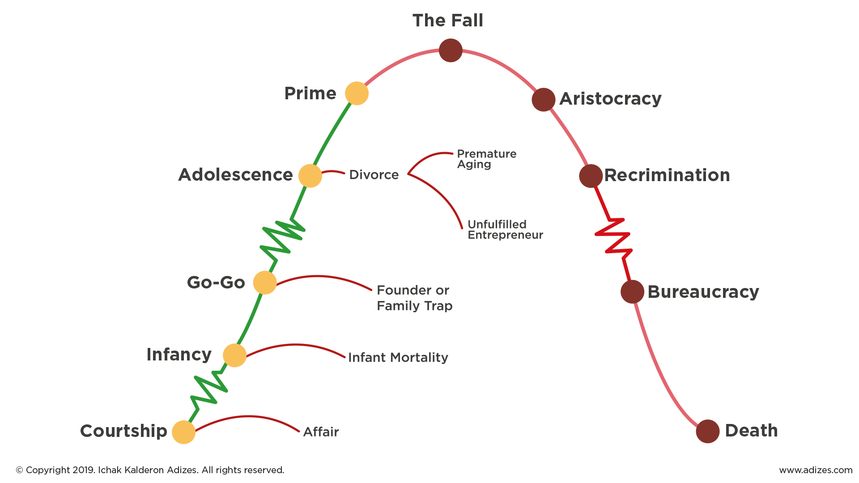
Notes:
ADIZES LIFE CYCLE MODEL. This is based on the life of the entrepreneur or an actual business owned by that founding entrepreneur. Everything in life begins with ideas.

Slide 40
LEADERSHIP BY SEASON
POTENTIAL
ORGANIZER
ORIGINATOR
OPERATOR
TIME
Notes:
If we apply this lifecyle to leadership by season of model of productivity we can see three very distinct roles in any activity. Activity originator, activity organizer and activity operator. They are distinct and separate. Originators and operators do not get along. The originators keep bringing new ideas and the operators say stop with the ideas, there is an activity that needs finishing. The organizer is unique in being able to see both sides. They allow the operator to steal the show by organizing the way the activity should operate.

Slide 41
LEADERSHIP BY SEASON
POTENTIAL
ORIGINATOR/
ORGANIZER
ORGANIZER/
OPERATOR
ORGANIZER
ORIGINATOR
OPERATOR
Notes:
Together we begin to see a blend. But each person has a place where they belong.

Slide 42
LEADERSHIP BY SEASON
POTENTIAL
ORIGINATOR/
ORGANIZER
ORGANIZER/
OPERATOR
ORGANIZER
ROLE OF THE LEADER:
ORIGINATOR
OPERATOR
SEASON OF THE ENTERPRISE
MOVEMENT
INITIATE
OPERATION
STRATEGIZE
INSTITUTION
EXECUTE
TIME
Notes:
As you hear this ask yourself “What role of leadership do I posses?” It’s usually very evident.

Slide 43
THE RECIPE FOR LEADERSHIP…
POTENTIAL
LEADERS MUST CREATE - OR - IMPORT:
VISION: “WHERE ARE WE GOING”
STRATEGY: HOW WILL WE GET THERE?”
ASSIGNMENT: “WHAT’S MY ROLE”
Notes:
Each of the roles create. What they create is:
When you have your table time you will have resources to help work through this.

Slide 44
“YOUR DISTINCTIVE CHARACTERISTICS”
Notes:
Now we are going to talk about the experiences that you have had that shape how you add value in your career.
This is something that is in constant flux and needs to be done as a reminder and updated as your experiences grow.
All of this is about learning to stay in your lane, stay in our role that God has gifted us with for the most impact.

Slide 45
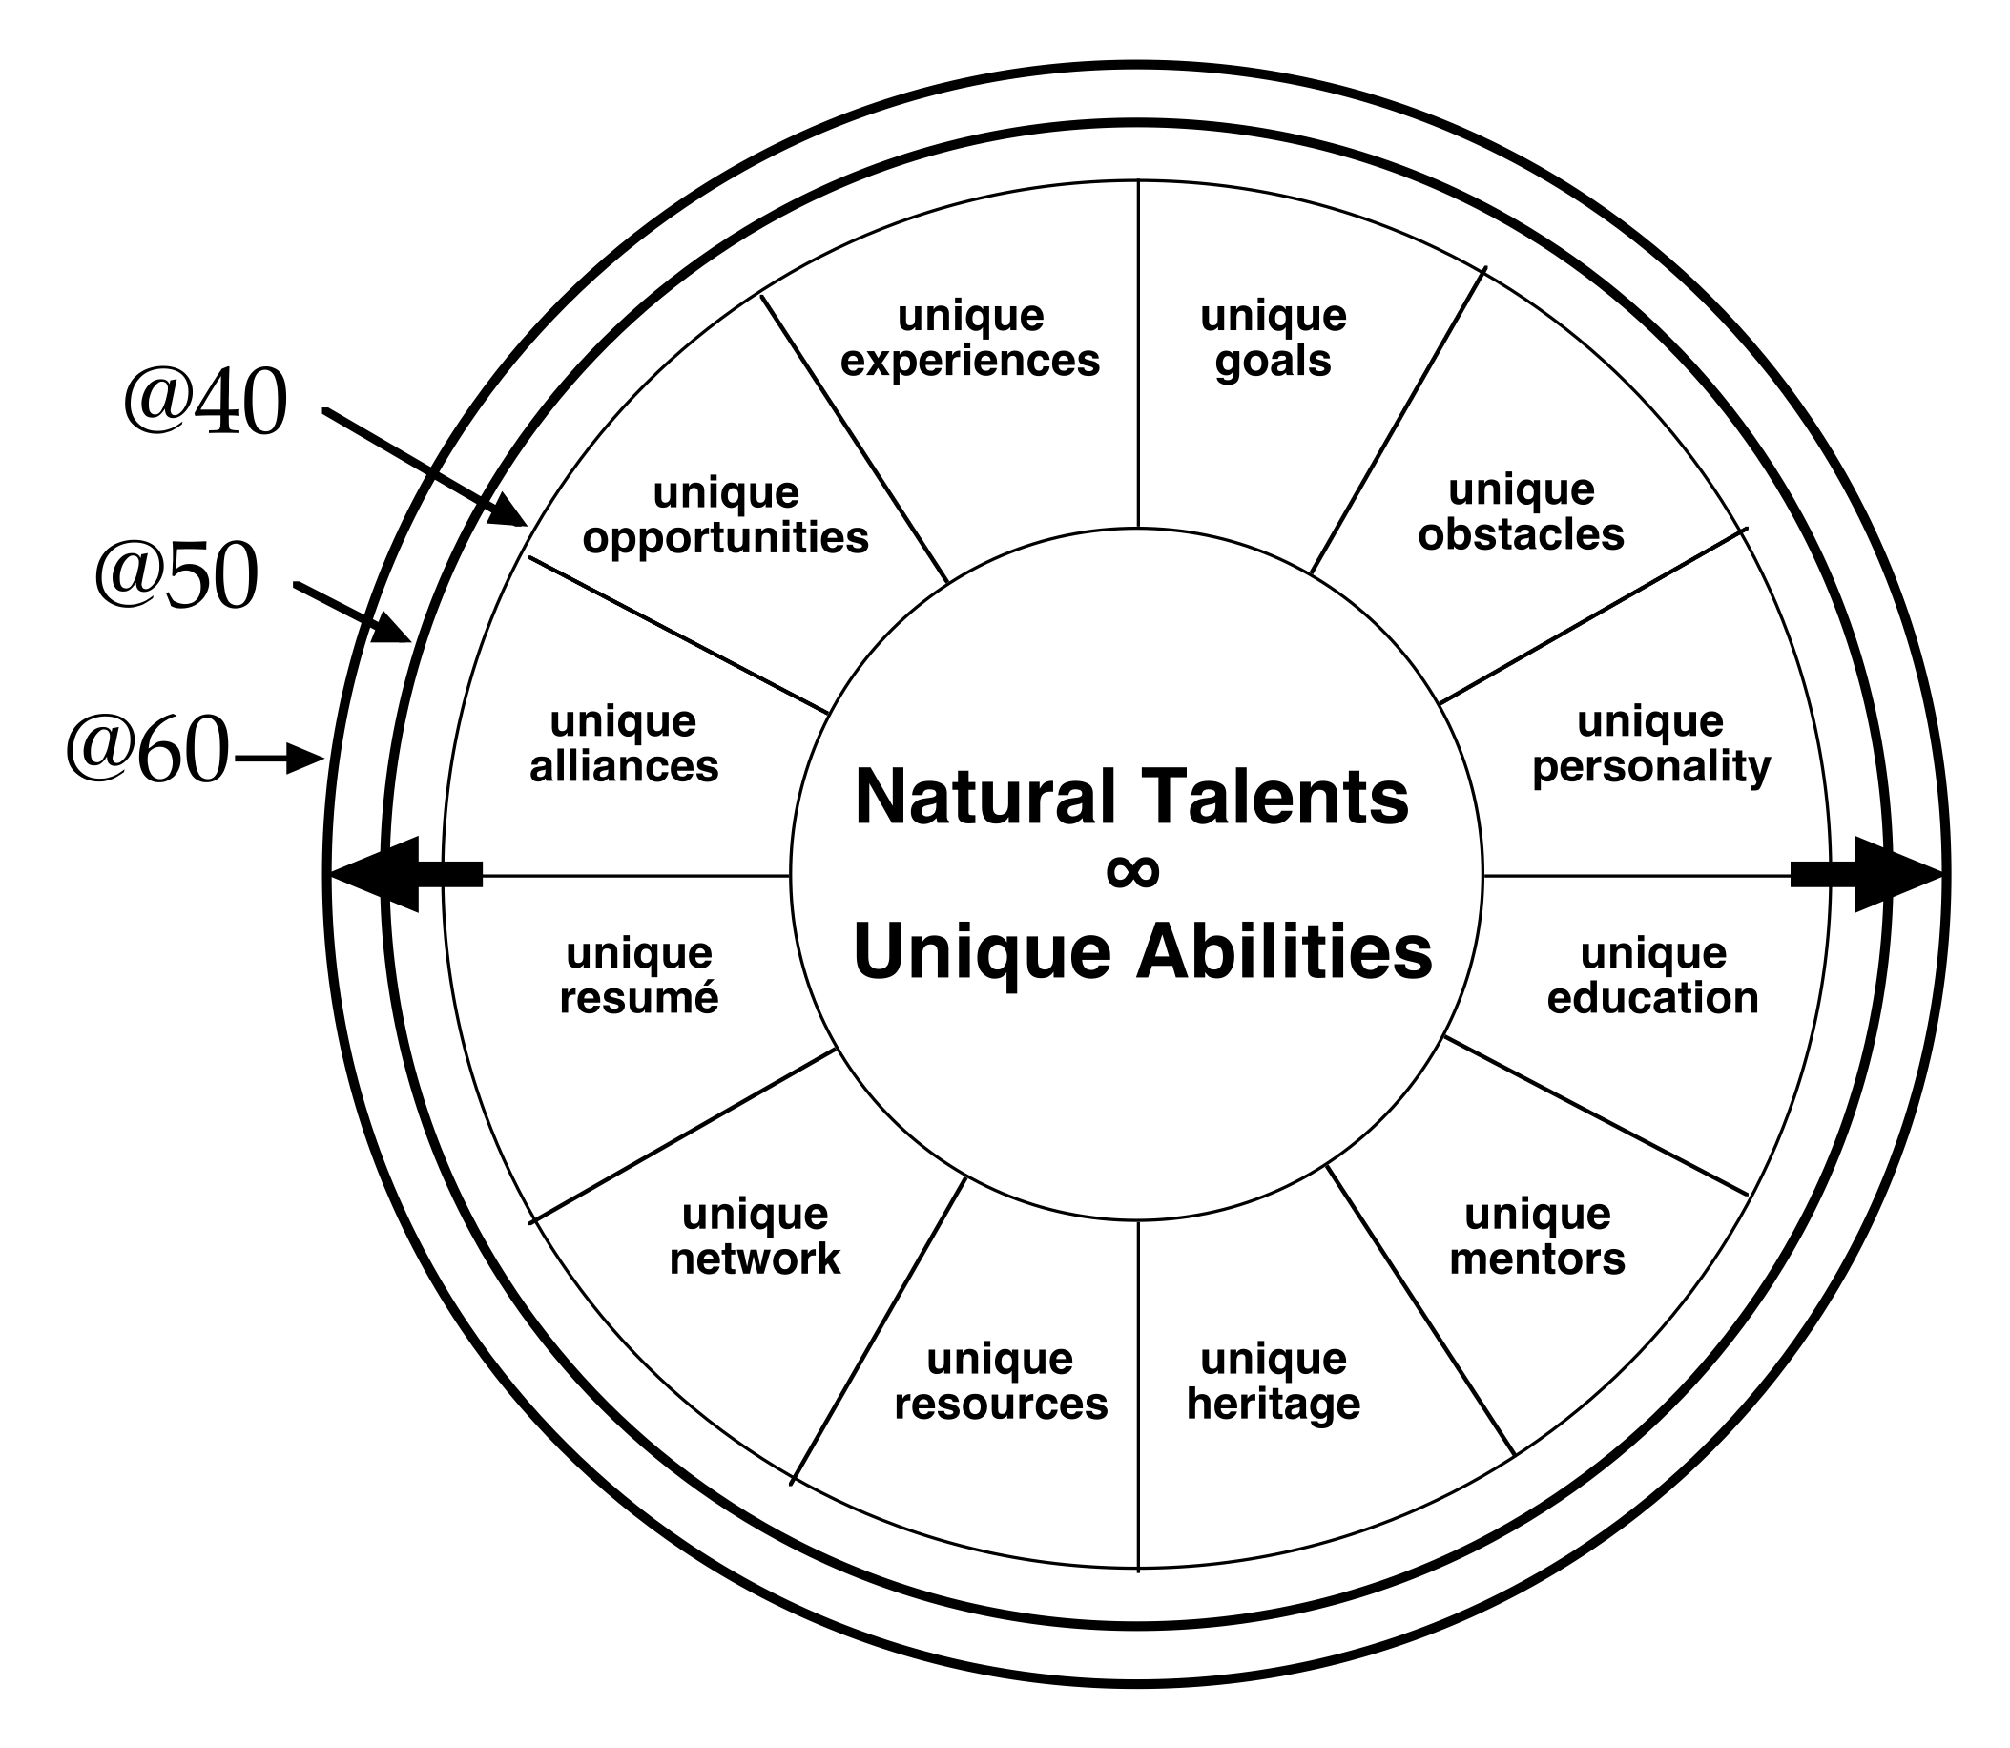
YOUR DISTINGUISHING CHARACTERISTICS BASED ON YOUR EXPERIENCES
Potential
Notes:
As we look at this each of these you will need to find three answers for each..

Slide 46
DISTINGUISHING CHARACTERISTICS:
COMPARATIVE VALUE IN CAREER PURSUITS
LOW:
OBSTACLES
HERITAGE
MODERATE:
RESOURCES
OPPORTUNITIES
MENTORS
GOALS
RESUME’
ALLIANCES
HIGH:
EDUCATION
PERSONALITY
NETWORK
EXPERIENCES
Potential
Notes:
The next step is valuing them low to high according to your career pursuits. When I use my personal characteristics and career pursuits this is how they line up.

Slide 47
YOUR DASHBOARD (ORIGINATOR)
UNIQUECHARACTERISTIC UNIQUECHARACTERISTIC
PASSIONATE
SHEPHERDING
ENCOURAGING
COACHING
NCSU BUSINESS/MARKETING
NADA ACADEMY
TMP
FUTURISTIC
STRATEGIC
ACTIVATOR
LEARNER
IDEATION
MY TOP FIVE NATURAL TALENTS
PERSONALITY
EDUCATION
NETWORK
EXPERIENCES
WORLD CHAMPION COMPETITORS AND COACHES
PRESIDENTS OF +9 DIGIT ORGANIZATIONS
OPENLY FAITH DRIVEN ENTREPRENEURS
LEADING ORGANIZATIONS
MULTIPLE ELITE PHYSICAL CHALLENGES COMPLETED
32 YEARS OF WORLD TRAVEL
MISSION TRIPS
PODCASTING
AUTHOR OF 3 BOOKS
UNIQUECHARACTERISTIC UNIQUECHARACTERISTIC
Notes:
When you have done this you use them to create a dashboard. This dashboard includes your leadership role, your top 5 natural talents and your personal unique characteristics. The most important will stand out because you will be able to identify how they have affected your mindset, impact or excitement in your career. You will be discussing this all around the table as well.

Slide 48
“STRATEGIC CAREER MANAGEMENT”
Notes:
So…..now that we have look at “your career and the Kingdom, the 80/20 principle, your God-designed potential, your role in productivity and your distinctive characteristics we are going to use those to strategically look at how you manage your career.

Slide 49
BATTLE READY CAREER OBJECTIVES:
FREEDOM TO REDESIGN YOUR CAREER
HIGH LEVERAGE PROFESSIONAL EFFORTS
MORE INCOME FROM LESS ACTIVITY
GREATER LEVELS OF AVAILABLE MARGIN
DAYLIGHT FOCUS DAYS REDIRECTED TO PURSUE YOUR KINGDOM CALLING
Notes:
You can on your terms craft it to how you want it to look
The best of you to be optimized out of your unique genius. Start there and then work out. Keep trying to force yourself back to center. Remember if you create value in a way that NO BODY else can, you have no competition in a market designed specifically for you.
This is not about getting rich, it’s about maximizing your value and using this to underwrite Kingdom initiatives. Using part of this can lead to success, using ALL of it leads to KINGDOM impact because you don’t use margin for you, you use it for the Kingdom.
More margin means more time, more availability and ability to participate in Kingdom initiatives. Initiatives that God has laid specifically on YOUR heart. Your career can UNDERWRITE the Kingdom initiative….complete mindshift about your career.
working/vacation

Slide 50
YOUR PROFESSIONAL CHALLENGE…
-DO YOUR JOB?
OR
-MAXIMIZE YOUR POTENTIAL?
Notes:
The goal today is to begin to see how do you maximize your potential. When this happens you will begin to move from a time deficit to a time surplus. When this happens alot of people begin to feel guilty, out of sorts, in transition because now you can breathe. Most don’t want that because that is actual success and most people don’t know how to handle it. because they have just lived life on the hamster wheel. This exercise helps you find the “next”

Slide 51
MANAGING YOUR CAREER ASSETS:
NATURAL TALENT/UNIQUE ABILITIES
DISTINGUISHING CHARACTERISTICS
YOUR ROLE IN PRODUCTIVITY
Notes:
You are going to have to fight for these. Fight to stay in your lane. Fight to fulfill your value. There WILL be opportunities that come along that are completely out of these and they WILL become time and energy bandits, ministry opportunities that are not in your lane…..
Where do you begin?

Slide 52
PERFORM A CAREER ASSESSMENT:
PROFILE YOUR TYPICAL WEEK, AND THE TIME COMMITMENTS WITHIN IT.
ESTIMATE THE HOURS SPENT IN EACH OF YOUR RECURRING COMMITMENTS.
EVALUATE WHAT YOU’RE UTILIZING IN EACH:
ARE YOU INEPT?
ARE YOU USING SKILLS?
ARE SKILL AND KNOWLEDGE IN USE?
ARE YOU ENGAGING YOUR TALENTS?
Notes:
You will find yourself signing yourself up for things that you can do but it’s not the best of you it’s not the best use of your talents and in a few weeks your heart isn’t in it anymore. It’s ok….take a machete to it and get close to center. SMART leaders say no and send it to someone in their circle that it does fit and it flourishes.

Slide 53
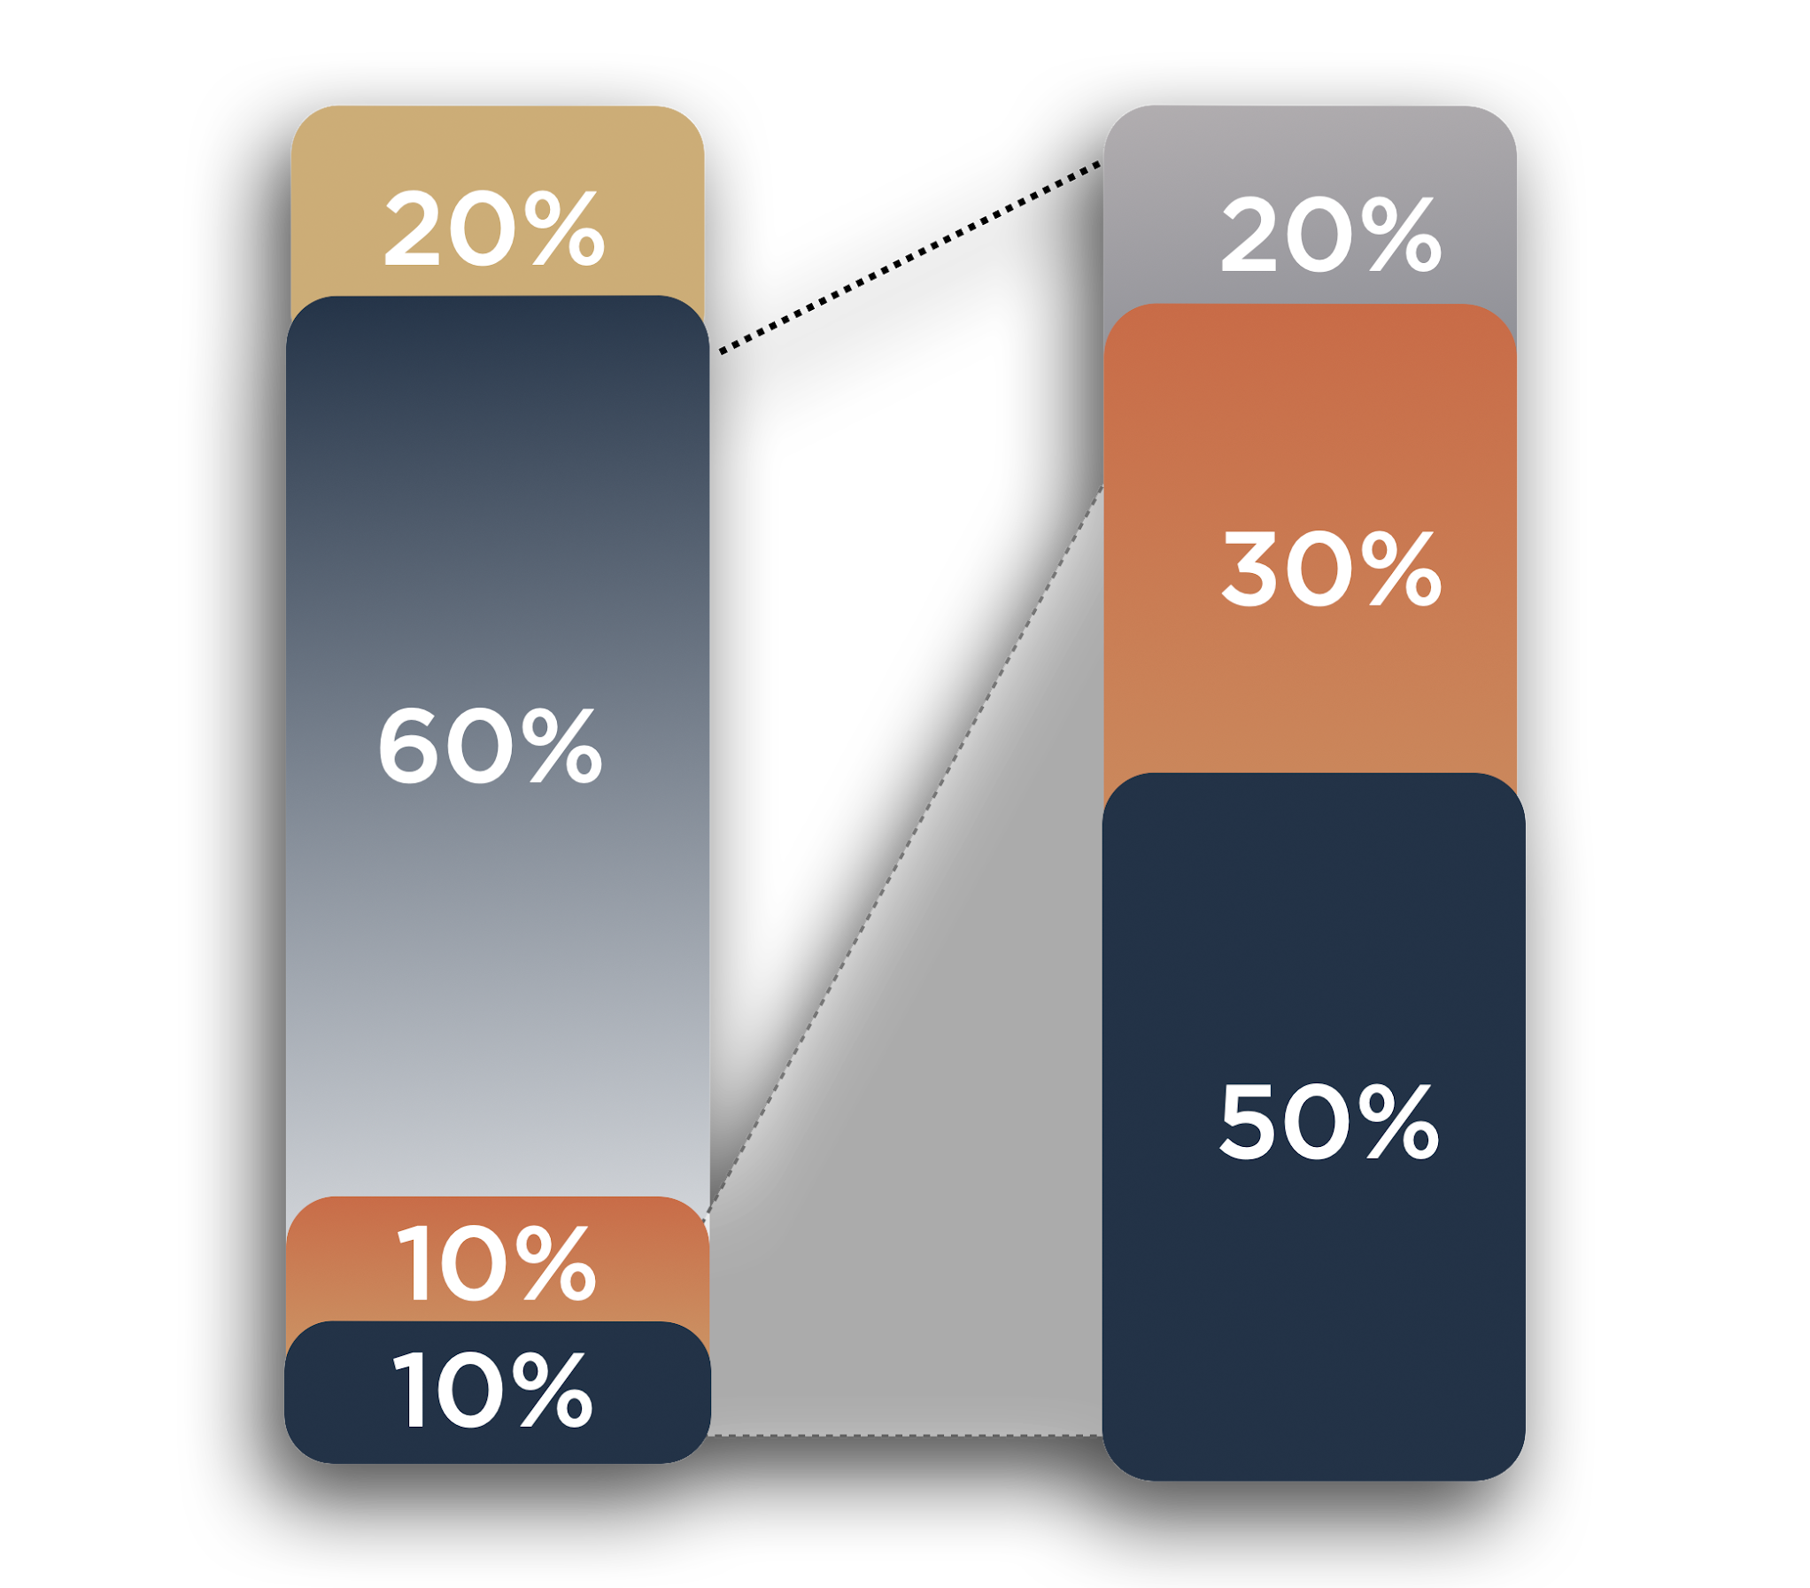
YOUR MARGIN-BUILDING STRATEGY:
ELIMINATE
IMMEDIATELY
MARGINAL
RESULTS
LIMITED
RESULTS
ERADICATE
SYSTEMATICALLY
SUSTAIN
INTENTIONALLY
MAJOR
RESULTS
MULTIPLY
STRATEGICALLY
EFFORTS RESULTS
Notes:
Most don’t really evaluate the TRUE and COMPLETE costs then they look at what they have on their plate.They just get comfortable managing chaos.

Slide 54
HOW TO REALLY EVALUATE CAREER OPPORTUNITIES…
YOUR 5
TOP
TALENTS
FUTURISTIC
STRATEGIC
ACTIVATOR
LEARNER
IDEATION
HOW MANY OF YOUR NATURAL TALENT WOULD BE EMPLOYED?
HOW MANY DISTINGUISHING CHARACTERISTICS WOULD ADD VALUE?
WOULD YOUR NATURAL ORDER BE IN ALIGNMENT WITH THE ENTERPRISE?
ORGANIZER
ORIGINATOR OPERATOR
Notes:
When the opportunities come how do you evaluate them?
For me it is a minimum of 3 of my talents are being used.
When I hear the opportunities I immediately begin to see a solution or a path which means it fits my distinguishing characteristics because my natural genius lights up.
Does it let my natural leadership position of originator come to life.
Does it have Kingdom impact.

Slide 55
AROUND THE TABLE TIME

Slide 56
BOOK LIST FOR SESSION 5
“STRENGTHS FINDER 2.0: DISCOVER YOUR CLIFTON STRENGTHS”
BY TOM RATH
“THE 80/20 PRINCIPLE: THE SECRET TO ACHIEVING MORE WITH LESS”
BY RICHARD KOCH

Slide 57
www.battlereadyman.com
NEXT DATE AND SUBJECTS:
JULY 27TH “YOUR RESOURCES”
AUG 31ST “YOUR MISSION”

