Slide 1
BATTLE READY
Psalms 144:1
Notes:
I hope at this point you are beginning to see how each of these sessions build upon the last.
We started by developing goals and strategy for building our launching pad of Body, Soul, Mind and Spirit.
Then we moved into understanding the calls of God and how we are stewarding our Family.
That led us mastering time and building margin and how to deploy that Margin in to Kingdom initiatives.
We’ve discussed Career and the Jesus’s view on the resources it creates…

Slide 2
“YOUR LIFE MISSION”
Notes:
So, how do we take all of those and beginning to develop our Life Mission?
That begins with a fresh perspective of our MAIN MISSION.

Slide 3
“A FRESH UNDERSTANDING OF
THE GREAT COMMISSION”
Notes:
our Co-mission with God….

Slide 4
CHURCHGOERS:
HAVE YOU HEARD OF THE GREAT COMMISSION?
8%
NOT SURE
17%
YES, AND IT MEANS…
51%
NO
25%
YES, BUT I CAN’T TELL YOU WHAT IT MEANS…
Notes:
It’s hard for us at Englewood to believe this, because we hear it weekly, but the majority of churchgoers don’t know what the Great Commission is.
(#’S)
That means that when you walk in the average church half of the room has no idea of the most important thing on God’s heart.
Today we are going to make sure that there is a clear understanding of the Great Commission…WHY? Because that is a MASSIVE part of your individual Life Mission.

Slide 5
The eleven disciples traveled to Galilee, to the mountain where Jesus had directed them. When they saw him, they worshiped, but some doubted. They asked him, “Lord, are you restoring the kingdom to Israel at this time?” Jesus came near and said to them, “It is not for you to know times or periods that the Father has set by his own authority. All authority has been given to me in heaven and on earth. But you will receive power when the Holy Spirit has come on you, and you will be my witnesses in Jerusalem, in all Judea and Samaria, and to the ends of the earth...
Notes:
What does scripture say about it?

Slide 6
Go, therefore, and make disciples of all nations, baptizing them in the name of the Father and of the Son and of the Holy Spirit, teaching them to observe everything I have commanded you. And remember, I am with you always, to the end of the age.” After he had said this, he was taken up as they were watching, and a cloud took him out of their sight.
(blended) Matthew 28:16; Acts 1:6-9

Slide 7
COMMISSION CLARITY
#1
DOUBTS- “MENTAL MISGIVINGS” - DO NOT DISQUALIFY PEOPLE FROM SIGNIFICANT KINGDOM ASSIGNMENTS
Notes:
Let’s understand the Commission Clarity and WHY Jesus said those things to his followers.
#1 Doubts
The great commission is a commandment, it is not an option. There are alot of people who say, I’m not qualified, so and so is more gifted…they have more time…..
We have ALL been given this command to steward in our lifetime.

Slide 8
COMMISSION CLARITY
#2
HUMAN PERSPECTIVE ABOUT WHAT REALLY MATTERS USUALLY FALLS FAR SHORT OF GOD’S DESIRES OR DIRECTIONS.
Notes:
#2
Another way to articulate this is the same way we talked about the ceiling of complexity. We place these imaginary or comfortable redlines on ourselves based on human perspective.
A great quote is “Why play only in your backyard when God has made you world class?”
We put these perspectives on ourselves and thereby place limitations on what God can do through us.

Slide 9
COMMISSION CLARITY
#3
GOD HAS RETAINED AUTHORITY OVER EVERYTHING HAVING TO DO WITH THE END OF THE AGE.
Notes:
#3
He’s the one in control. Scripture says: We are his ambassadors and he is reconciling others to him through us.
We are distribution channels of the blessing… tools and instruments of the great commission to be acting out the reconciliation of people to God’s love.
Disciples learn and become more like him by living in him,
apostles are sent out.
We are made to be not only disciples but apostles.
Remember, we began this journey by discussing soul relationship development.
Soul relationships are horizontal.
Our circle of influence is our playing field.
This could be the influence you have in your immediate community or,
if you grow that circle to include other cities or countries and they become your field.

Slide 10
COMMISSION CLARITY
#4
GOD HAS DELEGATED AUTHORITY THROUGH HIS SON, WITH HIS SPIRIT, TO CHRISTIANS FOR THE WORK HE WANTS TO DO LEADING UP TO THE END OF THE AGE.
Notes:
#4
Do you realize that WE are a part of that work? It’s not just our pastors or those on to the mission field.
Pull out your phones….How many contacts do you have there?
The average church in America has 200 members….
To be considered a megachurch there has to be over 2000 members.
Yes, by the #’s Englewood is a mega church….
The average megachurch has 700 attendees each weekend…..
I have 939 contacts in my phone, 6,412 contacts on LinkedIn, 3,588 friends on FB, 1,986 followers on IG assuming very little overlap that’s over 12,000, if I assume 50% overlap it’s over 6000 THREE megachurches…..Who has more influence?
Jesus said in his last breath that HIS work was finished…. Now
Our command is to use our unique talents and giftings and this influence to do our WORK of the Commission.
These contacts and that technology are gifts to be deployed for the WORK we have to do.

Slide 11
COMMISSION CLARITY
#5
JESUS MADE THE ASSIGNMENT CLEAR AND SIMPLE:
MAKE DISCIPLES
Notes:
#5
We don’t just cast the net, we are to bring them in and grow them up in the faith…FULL MATURITY.
That means graduating them from infancy through adolescence to maturity in Christ.

Slide 12
COMMISSION CLARITY
#5
JESUS MADE THE ASSIGNMENT CLEAR AND SIMPLE:
GO + BAPTIZE + TEACH
THE STRATEGY TO MAKE DISCIPLES:
Notes:
What is that strategy?
(slide)
Again Jesus made it simple and clear…….
And it is NOT optional.
We have been given the cure to the cancer of the human soul….
Jesus has given this though his grace and commands us to give it away and not just give it away but to show others how to give it away.
The gift of grace has NOT been given to us for our own consumption…

Slide 13
TO WHOM WILL YOUR GREAT COMMISSION WORK BE DIRECTED?
-BE A DISCIPLE
CHURCH-
THOSE THAT WANT TO FOLLOW JESUS
-WORLD
THOSE THAT HAVE NOT YET MET OR DECIDED
-MAKE
DISCIPLES
-GO
-BAPTIZE
Notes:
In terms of being disciple you have 2 specific areas
The church….make disciples, grow them, teach them bring them to maturity
The world…go and reach them, baptize them,
And it’s NOT one OR the other….these are going on at the same time ALL the time….
Remember back to session 1 when we talked about benchmarks…
benchmarking is a way to analyze whether you are just hearing this truth or actually acting out on the truth…
.that means benchmarking your commission participation should be a part of that.
That means assing things like,
1) how many people have I brought to Christ this year
,
2) How many people am I bringing up and discipling to maturity this year,
3) how many things with my resources do I see a net kingdom return on that investment that he has entrusted in us.
If you had #’s in each of those key measurables and laid all of those on a table at the end of each year you would see an increase in your faith that coincided with those #’s.
Remember your work for the Kingdom is always rewarded.…
If you are living in a stale faith life currently….take a look at those #’s currently.
There will be time around the table to make this personal to you.

Slide 14
“LIFEMISSION BRANDING”
Notes:
When it comes to Life Mission and launching your life Mission there are some important things to consider.
The FIRST of those is who YOU say you are.
People define us with titles.
As you are defined by others you become boxed by a list of expectations associated with that title.
At this point in the Battle Ready process it’s time to unbox the expectations and understand that there is something very special about you as an individual and God made you uniquely for a certain mission to help fulfill HIS mission.
This section is about dissecting the clues inside of us to discover that mission.
How many of you when you meet someone new at a meeting or a social gathering use your name and what you do to define who you are?
This process will give you a clear way to answer the question of who you are in a way that points to your assignment from God.
In Battle Ready there are three pillars of strategy that need to be in place.
Those pillars have to be in place in order to move forward with defining yourself.
That is the reason we have spent so much time up to this point building up the infrastructure.
Your Life Mission will be proportional to the strength of the infrastructure you put in place.
Battle Ready starts with a life in balance.

Slide 15
OBSTACLE #1: AN ABSENCE OF BALANCE
CHURCH
SPOUSE
CHILDREN
BODY
MIND
BATTLE READY
LIFE IN BALANCE
CAREER
SPIRIT
RESOURCES
SOUL
THE WORLD
Notes:
Remember this diagram? There are 10 areas that need constant assessment and refinement to a point of excellence.
From the core: Body, Mind, Soul, and Spirit
there is an abundance that transfers to my spouse, children, career and resources.
And that abundance when done in integrity pours over into opportunities to serve Christ body, the church, and those who don’t know him yet, the world.
All of these areas need the best of me, and that begins at the core of me.
When we look at how we refine these areas we ask ourselves 4 questions:
1 what’s right?
2 what’s wrong?
3 what’s missing?
4 what’s confused?
If I intend to live a life in balance I intend to see all of these in excellence.
that means continual refinement.
A life out of balance takes us out of the game and out of the mission.
A life out of balance feels like you have a 5 lb bag and 10 lbs of sand to put in it.
A life in balance will have a lot of margin.

Slide 16
OBSTACLE #2: AN ABSENCE OF MARGIN
THE 80/20 PRINCIPLE
TO CREATE MARGIN
ELIMINATING LOW
RETURN EFFORTS;
MULTIPLYING HIGH
RETURN EFFORTS
TIME
SPENT
TIME INVESTED
20%
80%
EFFORTS RESULTS
Notes:
Remember this diagram?
This is another area that requires continual refinement.
We know that things that get the most of me, get the best results.
Bringing back the refinement process here is about elimination, delegation and automation.
This process allows for headroom for the area that you are most qualified and equipped for.
As refinement happens you will begin to ask yourself:
is this thing I am doing what I am the most qualified for?
Is it what I am uniquely equipped to do?
If not, you need to eliminate or automate or
even better delegate to someone who is more qualified and uniquely equipped.
This allows others to lift up their contribution and results for the Kingdom as well.
Time is the most valuable commodity.
if you are not in control of it then you are not retaining margin for yourself.
And the lack of margin becomes a significant obstacle to the Life Mission and Kingdom impact you were created for.
Most people think that their availability to answer a Kingdom Call depends on wealth or finances.
That isn’t so, it is 100% dependant on the mastery of your time.

Slide 17
OBSTACLE #3: AN ABSENCE OF FOCUS
CALLING CONVERGENCE
OPERATING IN THE SWEET SPOT OF WHO GOD CREATED YOU TO BE
POTENTIAL
PASSION
PURPOSE
Notes:
So, being in balance and having margin is critical but then you have to this…..FOCUS.
What we are going to deep dive into is:
God, who did you make me to be?
What are my passions?
What is my purpose?
When we answer these questions we will find the convergence of what God calls us to.
This process will clarify our YES.
It also helps us understand the importance of “no’s”
Our “No’s” need to grow, not because we aim to tell people no, but
so that our God created “YES” can dominate our calendar, approach to life and mindset.
Standing here talking to you about all of these is part of my calling.
It dominates a lot of my thoughts,
I feel driven to share what I have learned so
others can find out the answers of those questions for themselves and answer the call of God on their life.
Discovery of this is where we are going.
We have to take the 3 obstacles
Absence of balance,
absence of margin and
absence of focus) and move them to advantages.
The key to that is understanding who you were made to be.
Some of these things will be reminders,
some of them will be new.
But what you have seen is the 3 pillars.
Having Balance,
Having Margin, and
Having Focus.

Slide 18
REBRANDING YOURSELF FROM A SUCCESSFUL CAREER TO A SIGNIFICANT CALLING.
Notes:
Branding yourself today means rebranding from who you have been defined as up to this point.
That means redefining how you introduce yourself.
Remember when we discussed career and resources we discussed redefining WHO we ultimately “WORK” for.
And…If you don’t see yourself in the word career substitute the word CREATIVITY…
Whether you are paid for it or not what is occupying your time…
what occupies you and has made you successful to this point moves from being your identifier to understanding you have a MISSION.
The God of the universe has called you to something that has eternal significance.
This rebranding begins from the inside out just like our power core.

Slide 19
PAUL’S CALLING/BRAND STATEMENT
We proclaim him, warning and teaching everyone with all wisdom, so that we may present everyone mature in Christ. I labor for this, striving with his strength that works powerfully in me.
COLOSSIANS 1:28-29
Notes:
Throughout this process we have examined Peter and Paul as examples.
Paul himself had a branding statement.
(Slide)
Paul understood the warning (some translations use admonishing here) and the teaching of the Gospel was vital.
Warning, admonishing and teaching are what we all need in our life.
We all need Paul’s in our life to hold us accountable to these warnings and teachings.
That is part of the wisdom we are seeking.
He also understood that there was a calling in the word and that the word worked in him by the strength of Christ.
When you see this statement begin to ask yourself, what is my statement?

Slide 20
THE PERSONAL BRANDING
HOW WOULD YOU INTRODUCE THESE PEOPLE?
ELON MUSK
BRENE BROWN
ERVIN “MAGIC” JOHNSON
Notes:
I’m sure most of you know at least some of these names,
how you personally feel about them is irrelevant
I just want to examine how each of them has moved or shifted their brand as life developed.
How they have changed their brand and defined themselves RATHER than being defined by others.

Slide 21
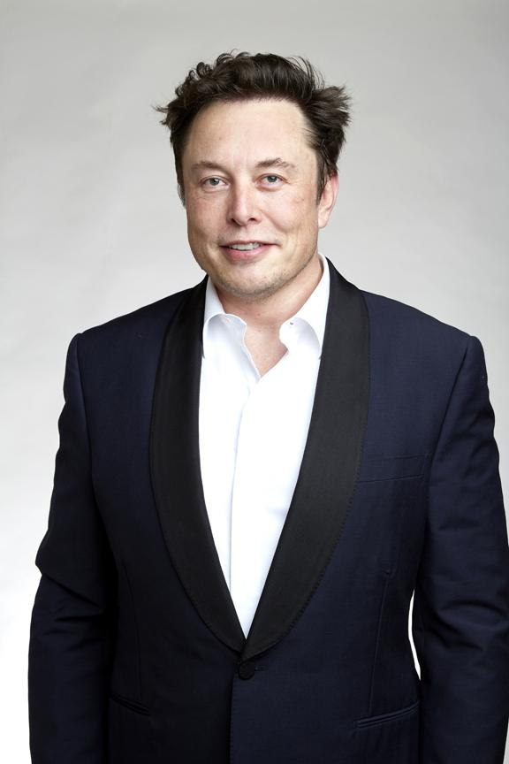
ELON MUSK
Notes:
Elon has made the news in a bunch of ways.
Coming from South Africa he saw opportunity in the US.
In that freedom and opportunity as an innovator he looked at what would it look like to build a car that was completely electric.
And that innovation was so much of an disruptive innovation it lead to governments and other companies saying “that is a good idea I want to follow that”
He was not defined by the car industry, he created a disruption from the bottom up,
Creating a brand that was defined by innovative ideas.
That has parlayed into missions to space, software companies, social media platforms.
In that he has defined himself as an entrepreneur that works without boundaries and if there are boundaries he is going to bust them wide open.

Slide 22
BRENE
BROWN
Notes:
Brown is a professor from Huston Texas.
She found that she could change the world by the study of shame.
Through the study of shame she found that the secret was vulnerability.
Her 2021 Ted TALK broke her from a professor with “odd” data to a consultant for Fortune 500 Companies.
She uses that data to make the best out their executive teams
.
She has written 6 NY Times #1bestsellers.
She could have been forever the professor with odd data.
Her passion for that study opened up opportunities outside of education to a multitude of platforms.
She moved from education, to corporations to nonprofits and now to the general public
.
What if that special thing that YOU have could cross platforms?

Slide 23
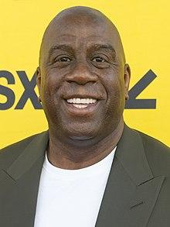
EARVIN
“MAGIC”
JOHNSON
Notes:
Earvin Johnson made his mark on basketball, I want to list those accomplishments:
McDonal’s All-American 1977
2x First-team All Big Ten 78,79
Second Team All American 78
Consensus First Team All american 79
NCAA Final Four Most Outstanding Player 79
NCAA Champion 79
5x NBA Champion 80,82,85,87,88
3x NBA Finals MVP 80,82,87
3x NBA Most Valuable Player 87,89,90
12x NBA All Star
9x All NBA First Team
4x NBA Assists leader
2x NBA steals leader
No 32 retired by LA Lakers
17,707 career points, 6,559 career rebounds, 10,141 career assists (the highest per game average in NBA history)
He is definitely in the conversation for one of the best Basketball players of all time, IF you define him by those stats.
What if he let his identity stay in Nov 7, 1991?
That is the day he went public about his HIV status.
There have been research papers written about the effect of that day, they call it the "Magic Johnson effect", in other words the effect Johnson's HIV announcement had on various populations, particularly those outside the stereotypes of who got infected with HIV. .
Johnson created the Magic Johnson Foundation to help combat HIV.
Until that day.HIV had been associated with intravenous drug users and homosexuals, but Johnson's campaigns sought to show that the risk of infection was not limited to those groups. Johnson stated that his aim was to "help educate all people about what [HIV] is about" and teach others not to "discriminate against people who have HIV and AIDS". Johnson was later criticized by the AIDS community for his decreased involvement in publicizing the spread of the disease.
He did not even let the diagnosis OR the HIV community define him or become his “BRAND”
Since leaving Basketball he has become active in other sports leagues…
He part of the executive management of the LA Dodgers,
He owns part of the WNBA’s LA Sparks,
LA Football Club (soccer),
and the NFL’s Washington Commanders (Redskins for those of us who remember the good ol’ days)
He has won 14 Sports championships, 6 as a player and 8 as an owner.
He could just be branded as a champion….
BUT
He is also the Founder and CEO of Magic Johnson Enterprises.
This conglomerate has a net worth of $700 million.
It has stakes in movie theaters, food services (if you have eaten at Disney you have eaten Magics food)
Cable TV networks, Real Estate,
a Life Insurance Company, which manages $14.5 billion in annuities, life insurance and other financial products.
He is one of only 5 professional athletes to achieve billionaire status.
In 2023 his net worth was listed at 1.2 billion dollars.
Yes, he faces struggles…he has an openly gay son…
Oh, and he is openly Christian, and has been quoted saying “ his faith is the most important thing in his life”…
in every opportunity he gives God glory…
What if he let his identity stay in Nov 7, 1991?

Slide 24
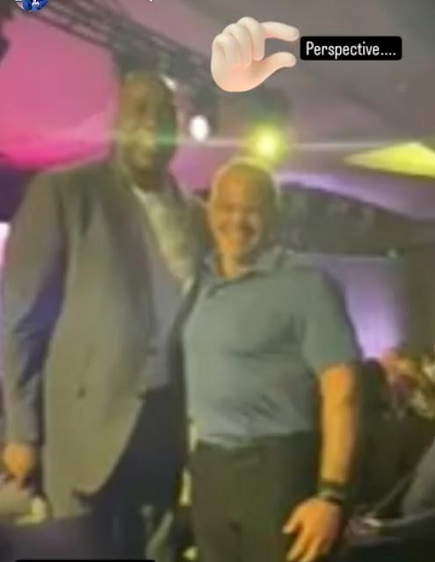

Slide 25
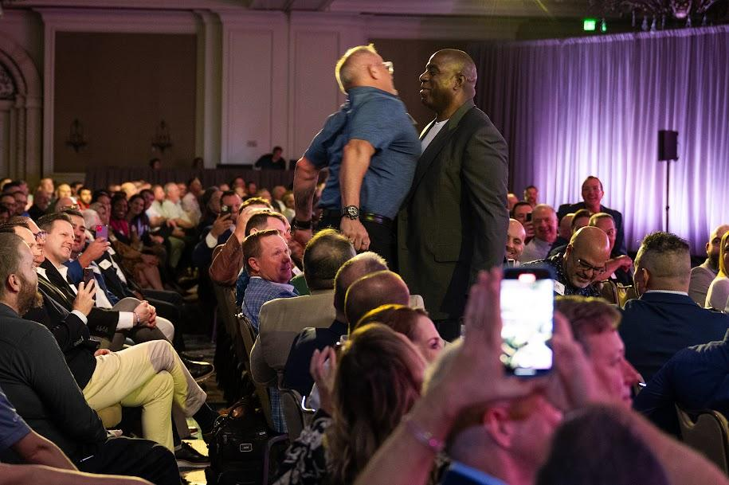

Slide 26
NAME
BRAND
CALLING
Notes:
Now all of those examples have moved from moment to moment staying true to themselves
over how other people saw them,
where other people told them they fit in
,
even when other people told them they had to leave.
Elon stepped away as CEO of Tesla
Brene left the education spac
e
Magic was forced into “retirement”
But they had calling that drove them.
This section is about getting well defined in these 3.
What does that look like?

Slide 27
CALLING
1
YOU’LL NEED A PIGEONHOLE
WHAT’S YOURS?
Notes:
If you are in your calling you will have a pigeonhole.
You hear all the time, “resist the pigeonhole” NO, Find and define the pigeonhole.
You are looking for the thing that ONLY you can do.
The thing you can’t find anyone else that serves that purpose, that people or potential clients can say “I can’t find anyone like you”
Find that spot for which God made you and DEFINE it because it’s YOURS!

Slide 28
CALLING
2
YOU’LL BE MOLDED
BY YOUR CORE VALUES
WHAT ARE THEY?
Notes:
You will be molded by the things that you care about most.
Those things you care about most are your core values.
Discovering your core values and writing them out matters.

Slide 29
CALLING
3
YOU’LL BE DRIVEN
BY YOUR PASSIONS.
WHAT ARE THEY AND ARE
THEY GOD-HONORING?
Notes:
There is a passion component as well, that reflex piece of “I care alot about this…”
Passion drives you past the acceptance by others,
it drives you past the headwinds.
You are going to need to know what your passions are and whether or not they are God Honoring.

Slide 30
CALLING
4
YOU’LL BE ENABLED BY
YOUR NATURAL TALENTS.
HAVE YOU DISCOVERED THEM?
ARE YOU NARROWING YOUR FOCUS?
Notes:
As we talked about a couple of sessions ago, God gave us natural talents to use to grow HIS Kingdom.
Those talents will enable us to do just that….
IF we know what they are and begin to FOCUS on their use
We need to embrace them.
Our tendency is to discount them as “not good enough”
Instead double down on them and continue to invest in them so they are exuding from you.

Slide 31
CALLING
5
YOU’LL BE KNOWN
FOR YOUR SPECIALITY.
IN WHAT ROLE WILL YOU PUT YOUR
NATURAL TALENTS INTO PLAY?
Notes:
When they begin to exude other people will begin to know you by them and your specialty.
The heading on your virtual business card is your name and your specialty.
(In what role….)”
This is what we are in search of.
Discovering this is important.
Why?

Slide 32
CALLING
6
PEOPLE WILL INTRODUCE YOU
BY YOUR BRAND DESCRIPTION.
HAVE YOU EDITED YOURS YET?
Notes:
Because, as you answer these questions it leads to how you are going to want people to introduce you.
You want them to introduce you using your brand description.
It’s like having a bumper sticker and people knowing exactly who’s driving based on what it says.
Have you edited yours yet?

Slide 33
YOUR BRAND:
HOW WOULD YOU LIKE PEOPLE
TO INTRODUCE YOU?
Notes:
This is one of the table exercises today…
Just know….It will take more than today to get it perfected…or at least worthy of a bumper sticker.

Slide 34
“CALLING CONVERGENCE
AND
YOUR PURPOSE”
Notes:
As we move away from branding, or how we begin to get introduced based our gifts we are going to start to examine where our calling is and our purpose while we are here on Earth.

Slide 35
WHAT'S YOUR CAPACITY?
POTENTIAL
HOW?
WHAT’S YOUR CAUSE?
PASSION
WHO/
WHAT?
PURPOSE
WHY?
WHAT’S YOUR COMPULSION?
Notes:
I hope you remember this diagram from the previous session where we talked about the triangulation of our potential, passion and purpose.
Diagram (explain the how, who/what and why)
as we look at this diagram we can see where activities in our life may fit into one or maybe a couple of the spaces.

Slide 36
WHAT'S YOUR CAPACITY?
POTENTIAL
HOW?
CAREER
WHAT’S YOUR CAUSE?
WHAT’S YOUR COMPULSION?
PASSION
WHO/
WHAT?
PURPOSE
WHY?
Notes:
If you are in a space where your potential is utilized at a high level and they are aligned with your passion that would be a REALLY good career.

Slide 37
WHAT'S YOUR CAPACITY?
POTENTIAL
HOW?
WHAT’S YOUR CAUSE?
WHAT’S YOUR COMPULSION?
PASSION
WHO/
WHAT?
VOLUNTEER
PURPOSE
WHY?
Notes:
Some activities we are involved in my combine our passion,
the who you are serving and with our purpose, they why you are serving,
but it requires very little of any of your natural talents…for example sweeping the church,
then it’s somewhat fulfilling it has a name……volunteer.

Slide 38
WHAT'S YOUR CAPACITY?
POTENTIAL
HOW?
DUTY
WHAT’S YOUR CAUSE?
WHAT’S YOUR COMPULSION?
PASSION
WHO/
WHAT?
PURPOSE
WHY?
Notes:
There are some activities that use your talent at a high degree, you are very clear on the why you are doing it but you lack any passion for it at all.
That is called duty.
It’s just an act of service you know you have to do.

Slide 39
CALLING CONVERGENCE
WHAT'S YOUR CAPACITY?
POTENTIAL
HOW?
WHAT’S YOUR CAUSE?
LIFEMISSION
WHAT’S YOUR COMPULSION?
PASSION
WHO/
WHAT?
PURPOSE
WHY?
Notes:
What we are looking for is LifeMission.
It’s the sweetspot of all of these things.
It’s where your talent is in FULL display with who or what you feel like serving based on the outcomes of the work that you were born to see happen.
This is called calling convergence.

Slide 40
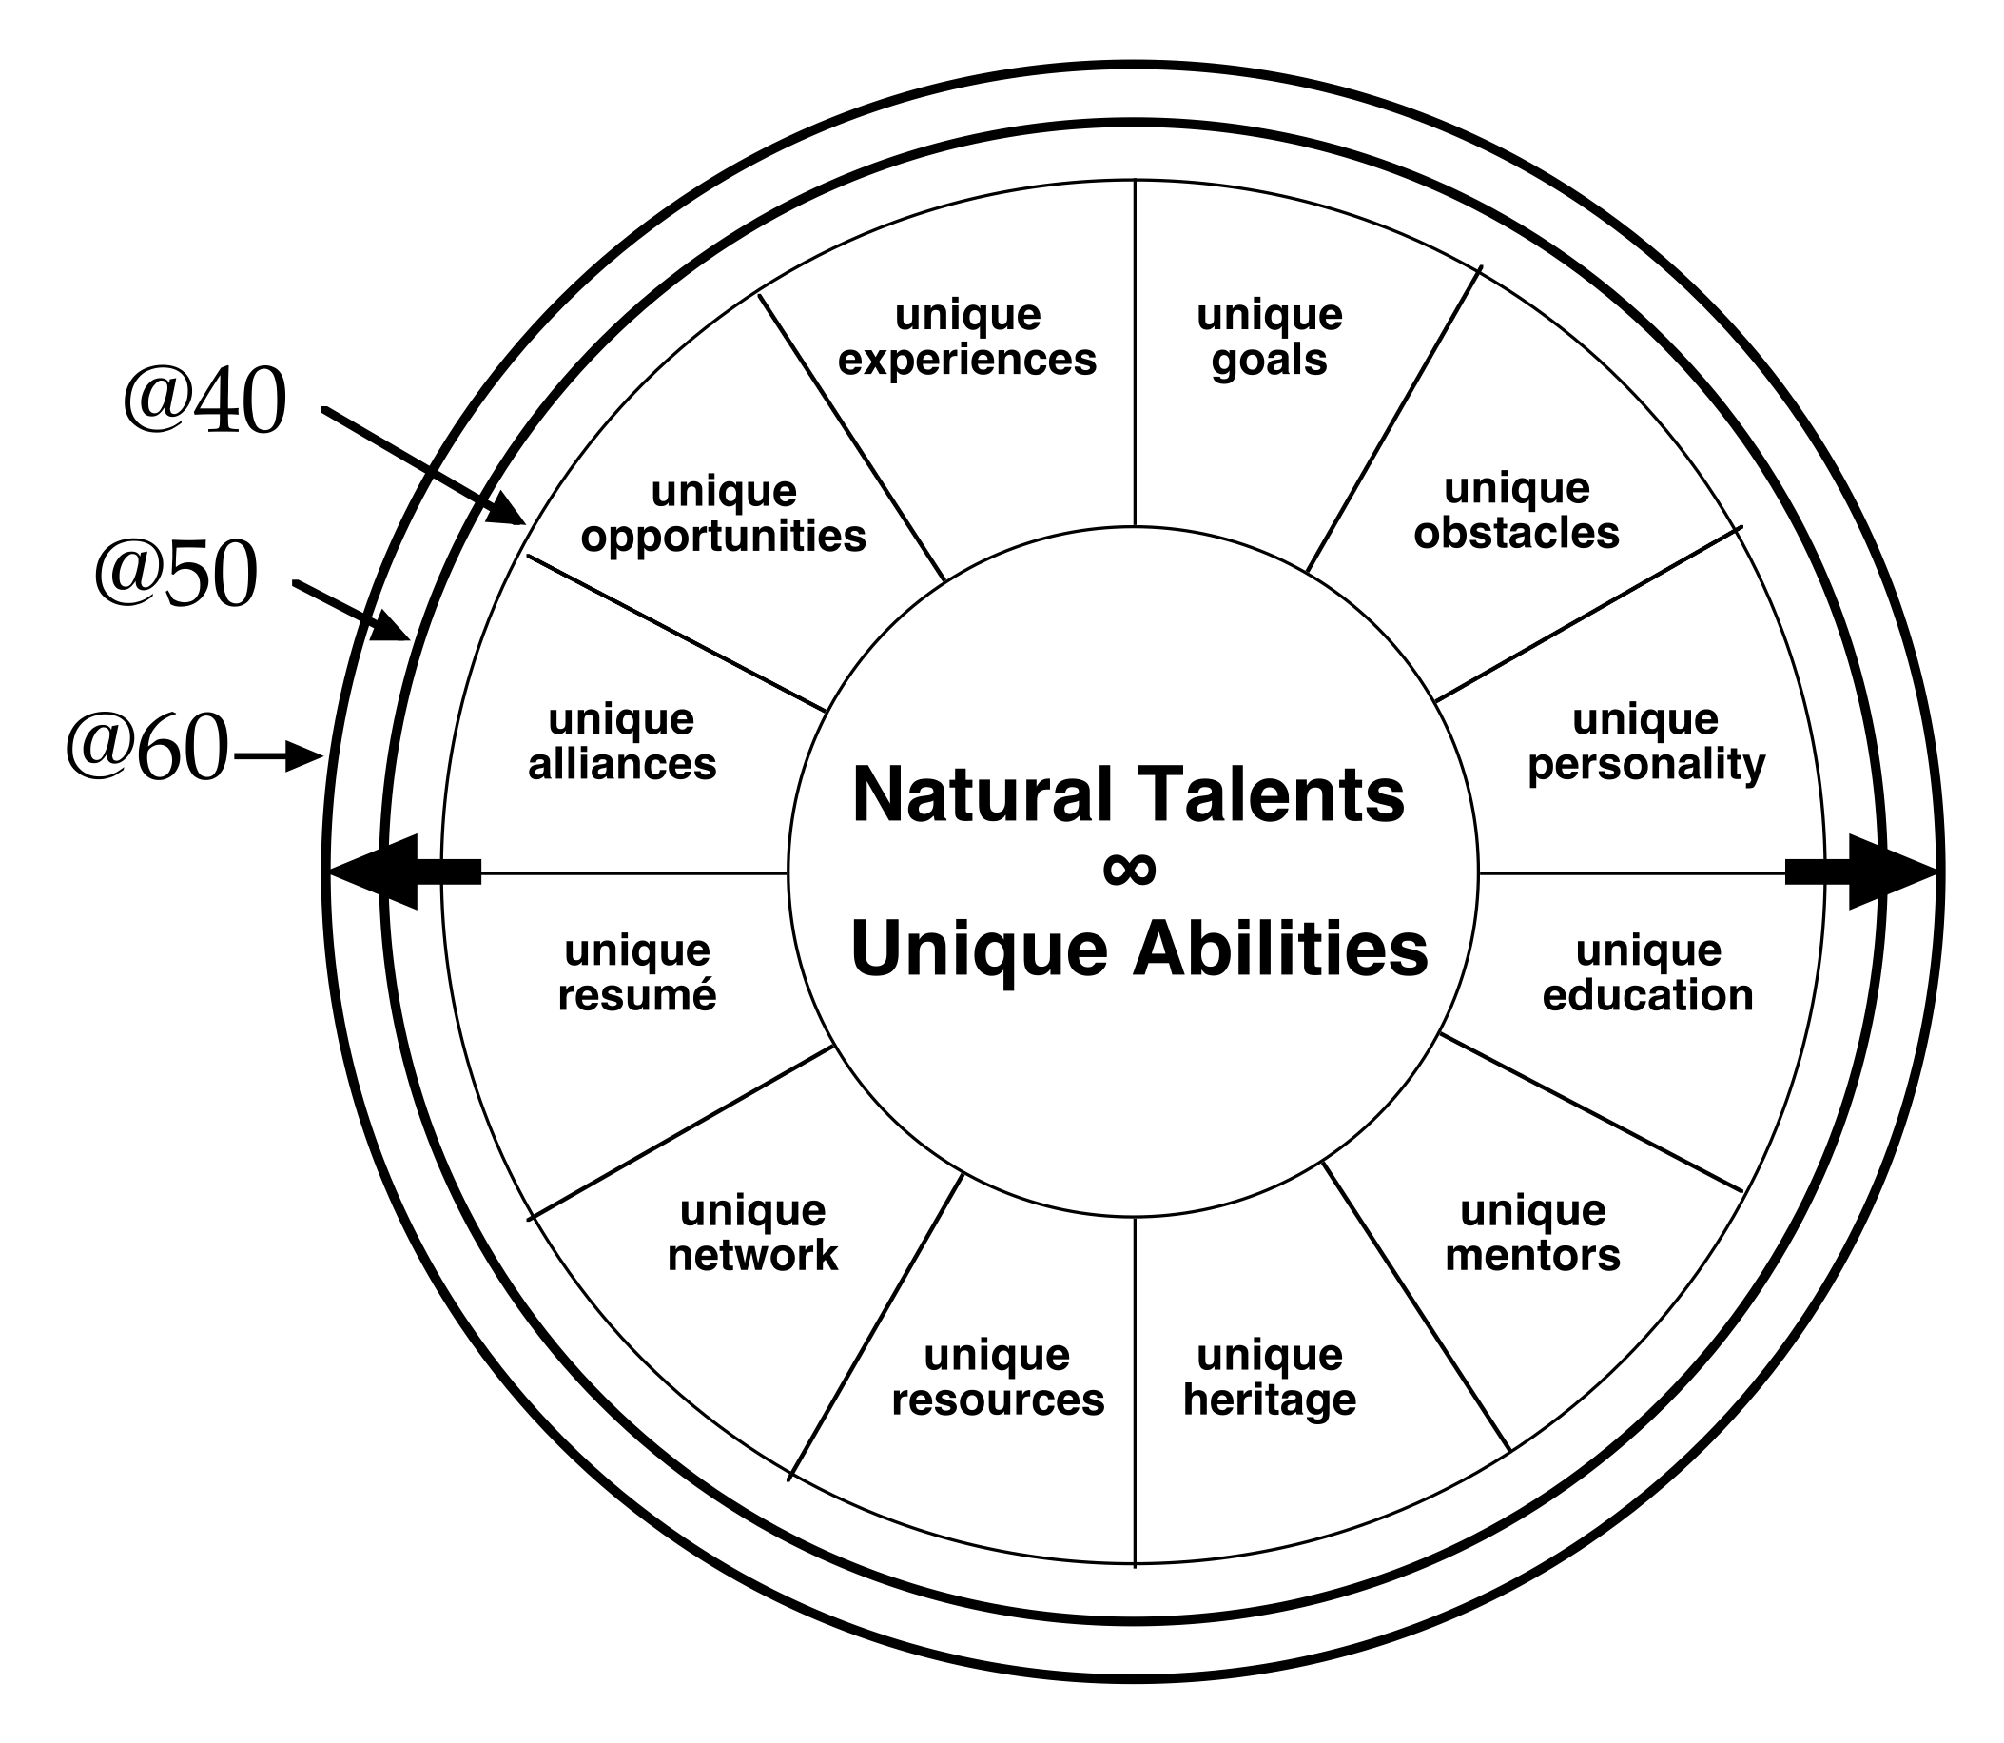
GOD-DESIGNED POTENTIAL
GOD’S CREATIVE GENIUS
EVIDENCED IN YOUR
SPIRITUAL DNA
NATURAL
TALENTS
&
UNIQUE
ABILITIES
Notes:
As we explore LifeMission and those three areas I am going to begin with Potential
Again, this is a diagram we have seen two sessions ago.
It is an efficient way to examine how you are being used based on the God designed potential.
It helps us see where we can be extremely effective with the use of our Natural Talents and Unique Abilities in a way that no one else has been designed to do.
We will spend time on this in future sessions

Slide 41
GOD HONORING PASSION
MY
HEART
GOD’S
HEART
HOLINESS: TRANSFORMING THE HEART FROM UNRIGHTEOUS TO RIGHTEOUS
Notes:
When we look at Passion, we look at God’s Heart coming alive in you.
Where what you care deeply about and want to see changed in the world is heavy on God’s heart.
The word desire when broken down to its beginning translation it actually tells us where they come from.
de - from
sire - father
from THE FATHER
We will unpack that in later sessions as well.

Slide 42
WHAT IS “PURPOSE?”
PURPOSE
“THE REASON FOR WHICH SOMETHING IS DONE OR CREATED, OR FOR WHICH SOMETHING EXISTS.”
WHAT IS YOUR PURPOSE?
Notes:
Today we are focused on Purpose
Slide…

Slide 43
WHAT IS “PURPOSE?”
PURPOSE
“THE MEANING OF LIFE IS TO FIND
YOUR GIFT. THE PURPOSE OF LIFE IS
TO GIVE IT AWAY.”
PICASSO
Notes:
Slide.

Slide 44
THE GREAT COMMANDMENTS
PURPOSE
And one of them, an expert in the law, asked a question to test him: “Teacher, which command in the law is the greatest?” He said to him, “Love the Lord your God with all your heart, with all your soul, and with all your mind. This is the greatest and most important command. The second is like it: Love your neighbor as yourself. All the Law and the Prophets depend on these two commands.”
MATTHEW 22:35-40
LOVE GOD, LOVE PEOPLE
Notes:
Jesus had a lot to say about purpose.
(slide).
This can be summarized this way….LOVE GOD, LOVE PEOPLE.

Slide 45
THE GREAT COMMISSION
PURPOSE
Jesus came to them and said, “All authority has been given to me in heaven and on earth. But you will receive power when the Holy Spirit has come on you, and you will be my witnesses in Jerusalem, in all Judea and Samaria, and to the ends of the earth. Go, therefore, and make disciples of all nations, baptizing them in the name of the Father and of the Son and of the Holy Spirit, teaching them to observe everything I have commanded you. And remember, I am with you always, to the end of the age.”
MATTHEW 16:18-20
MAKE DISCIPLES
Notes:
Again we see Jesus speak of purpose.
(slide)
This can be summed up as well….MAKE DISCIPLES

Slide 46
GOD’S KINGDOM PURPOSE
PURPOSE
LOVE GOD
LOVE PEOPLE
MAKE DISCIPLES
-SOURCE: JESUS
NOTE: NO MULTIPLE CHOICE OPTION; RATHER, IT IS ALL OF THE ABOVE.
Notes:
So,
(Slide)
If this is the Purpose of Jesus, then ANY purpose we have fits perfectly under that.

Slide 47
PURPOSE
LOVE GOD
LOVE PEOPLE
MAKE DISCIPLES
MYSTICISM, NOT KINGDOM PURPOSE
Notes:
It has to be all three…..

Slide 48
PURPOSE
LOVE GOD
LOVE PEOPLE
MAKE DISCIPLES
HUMANITARIANISM, NOT KINGDOM PURPOSE

Slide 49
PURPOSE
LOVE GOD
LOVE PEOPLE
MAKE DISCIPLES
FANATICISM, NOT KINGDOM PURPOSE

Slide 50
PURPOSE
LOVE GOD
LOVE PEOPLE
MAKE DISCIPLES
KINGDOM PURPOSE, AS MODELED BY JESUS
Notes:
Love God, Love People, Make Disciples is the Compass we should use to guide us to our purpose.
Whatever our individual purposes are they will always be about
Loving God, Loving People, and Making Disciples.

Slide 51
LOVE GOD
LOVE PEOPLE
MAKE DISCIPLES
PURPOSE
“I have glorified you on the earth by completing the work you gave me to do…”
JESUS IN GETHSEMANE QUOTED IN JOHN 17:4
Notes:
Let’s Jesus work was an how they gives us a picture of his purpose.
Remember we have talked about Jesus having a calling.
Here we see him in the Garden of Gethsemane actually praying just that
(slide)
God had commissioned Jesus to a set of work. That work had a purpose.
We can find lots of examples of that purpose.

Slide 52
PURPOSE
“A thief comes only to steal and kill and destroy. I have come so that they may have life and have it in abundance.”
JOHN 10:10
“For the Son of Man has come to seek and to save the lost.”
LUKE 19:10
“I was born for this, and I have come into the world for this: to testify to the truth.”
JOHN 18:37
Notes:
Here are just there of those references to purpose of the work. Remember, purpose is the WHY we do things….
(slide)

Slide 53
PURPOSE
“TO TESTIFY TO THE TRUTH AND TO SEEK AND SAVE THE LOST SO THAT THEY MAY HAVE LIFE, AND HAVE LIFE IN ABUNDANCE.”
JESUS (LUKE 19:10, JOHN 10:10, JOHN 18:37 BLENDED)
Notes:
If we take these examples we can create a LifeMission Statement.
(slide)
Take a look at the structure of the statement.
First is what Jesus is doing
Second is the reason he is doing it.
So when we develop Mission Statement for ourselves this is the structure for those statements…
What and Why.
The time around the table today for this session will be a first draft for that personal statement.

Slide 54
AROUND THE TABLE TIME

Slide 55
MY LIFE MISSION
Notes:
I’m Chris Vester, I am a bold man who acts with integrity and from love. I stand as a beacon pointing to God’s grace and mercy. My LifeMission is to lead men to Godly leadership of anywhere they place their feet and ministering to couples alongside Suzanne in a way that has a measurable impact on the success rate of marriages.
I hope you see how this statement helps me define my personal brand and what my mission work is and then the why I am doing it.
I hope you also see the larger mission in it as well….Love God, Love People, Make Disciples.
Today is about the first draft. There is a sample beginning framwork to get the juices flowing.

Slide 56
www.battlereadyman.com
Sept. 28 - Your Unique Role
Oct. 26 - Your Heart

Slide 57
Reading List:
“Radical: Taking Back Your Faith from the American Dream” by David Platt
“Strengths Based Leadership” by Tom Rath & Barry Conchie
“And Then he End Will Come” by Douglas Cobb

