Slide 1
BATTLE READY
Psalms 144:1

Slide 2
YOUR KINGDOM LIFE PLAN
Notes:
Over the last 9 sessions we have gone through alot.
understanding our power core of body, soul, mind, spirit,
Intentional discipleship of your family,
Developing the understanding that your career is your ministry
Stewarding our resources of time, talent and treasures for the kingdom.
Developing our life mission,
By understanding our unique calling and niche to serve by feeding our purpose, passion and potential.
All of these things culminate into the development of a Kingdom Life Plan that does 4 things:
It aims our lifemission
Shows us our life mission potential
Gives us our Lifemission Dashboard
And clearly defines the Kingdom Portfolio that funds our LifeMission

Slide 3
“AIMING YOUR LIFEMISSION”
Notes:
If you recall from our last session we began to examine our new name
I pray you have taken the time to examine the name that Jesus calls you as a follower.
Remember Jesus had a habit of renaming people
That new name contained their life mission and purpose
The power of our words as a blessing and a curse.

Slide 4
Notes:
These 12 started a movement that has impacted the people in this room

Slide 5
THE FOUNDERS
CLASS
SIGNIFICANCE
LIFE MISSION
TRANSITION
TRANSITION
TRAINING
TRAINING
BATTLE READY
VISION
VISION
WORK
CHURCH
FAMILY
FAITH
Notes:
The purpose of Battle Ready training is find what gives you the capacity to aim that mission.
Steps of responsibility.

Slide 6
BATTLE READY
THE FOUNDERS
CLASS
TRANSITION
TRAINING
VISION
Notes:
Vision begins when Jesus says: Follow me and I will make you…….
Have you answered that question yet?
What significant mission has God made you for?
Battle Ready is training that never stops, is constantly reevaluated and leads to transition and significance.
it leads to knowing you can do this and that you are who God says you are.

Slide 7
WHAT DO WE KNOW
ABOUT THE
FOUNDER’S CLASS?
TRANSITION
TRAINING
VISION
THEY WERE HAND-PICKED FOR THEIR LIFEMISSION
Notes:
Let’s look at how this founders class was trained and launched.

Slide 8
WHAT DO WE KNOW
ABOUT THE
FOUNDER’S CLASS?
TRANSITION
TRAINING
VISION
THEY WERE HAND-PICKED FOR THEIR LIFEMISSION
THEY WERE NAMED AND GIVEN VISION BEFORE THEY WERE TRAINED.
Notes:
Let’s look at how this founders class was trained and launched.

Slide 9
HOW WERE THEY TRAINED?
TRANSITION
TRAINING
VISION
THEY WOULD LEARN BY SPENDING TIME WITH JESUS.
Notes:
How were they trained.
Spending time with Jesus is all about listening. A Lot of time when Christians pray it’s all about them talking, what about listening to what he is saying?
When you begin to spend time listening to Jesus more and more on a daily basis you will see that he starts to speak in all circumstances in the day to day.

Slide 10
HOW WERE THEY TRAINED?
TRANSITION
TRAINING
VISION
THEY WOULD LEARN BY SPENDING TIME WITH JESUS.
THEY WOULD BE SENT OUT BY JESUS TO PRACTICE WHAT THEY WERE LEARNING.
Notes:
It’s one thing to learn and hear, it’s another thing to put it into practice.
Driving….
Time/Practice the same thing happens in lifemission.

Slide 11
WHAT WERE THEIR EMPHASES?
TRANSITION
TRAINING
VISION
JESUS SENT THEM OUT TO PROCLAIM THE GOSPEL AND MAKE DISCIPLES.
THE “SALES” COMPONENT
THE “SERVICE” COMPONENT
Notes:
This reference is not meant to be sacrilegious.

Slide 12
WHAT WERE THEIR EMPHASES?
THE “SALES” COMPONENT
CODE NAME:
EVANGELISM
TARGET CUSTOMER:
THE LOST; IE, THE WORLD
MESSAGE CONTENT:
GOSPEL OF SALVATION
Notes:
Evangelism doesn’t mean a preacher, missionary, there are plenty of ways to be transferring the message of the Gospel in the secular areas of life.
Those secular spaces may never get reached by the Church if we don’t do fulfill our calling in those spaces.

Slide 13
WHAT WERE THEIR EMPHASES?
THE “SERVICE” COMPONENT
CODE NAME:
DISCIPLESHIP
TARGET CUSTOMER:
THE SAVED; IE, THE CHURCH
MESSAGE CONTENT:
GOSPEL OF THE KINGDOM
Notes:
This is a VERY underrepresented area of the Kingdom.
Battle Ready shows very clearly how to be a disciple maker.

Slide 14
WHAT WERE THEIR EMPHASES?
TRANSITION
TRAINING
VISION
JESUS SENT THEM OUT TO PROCLAIM THE GOSPEL AND MAKE DISCIPLES.
THE “SALES” COMPONENT
THE “SERVICE” COMPONENT
HE SENT THEM OUT TO NEUTRALIZE THE OPPOSITION.
Notes:
Jesus had a task to take out the enemy.
If you go on the mission field the enemy is obvious
In America the enemy tries to convince us there is no spiritual battle taking place.

Slide 15
10 “A thief comes only to steal and kill and destroy. I have come so that they may have life and have it in abundance.”
JOHN 10:10
“The Son of God was revealed for this
purpose: to destroy the devil’s works.”
1 JOHN 3:8
Notes:
It is part of our purpose just like it was Jesus’s purpose.
Satan operates in lies.
Overcoming the lies people believe about themselves is the first step in defeating the enemy.

Slide 16
TRANSITION
YOUR KINGDOM LIFE PLAN?
TRAINING
VISION
YOU HAVE BEEN HAND PICKED
JESUS HAS A VISION FOR YOU
HE’S PLACED YOU IN TRAINING AND ASKED THAT YOU FOLLOW HIM
YOU WILL NEED TO PRACTICE WHAT YOU ARE LEARNING
YOU WILL NEED TO EMPHASIZE “SALES” OR “SERVICE”
YOUR KLP WILL HAVE OPPOSITION THAT MUST BE NEUTRALIZED.
Notes:
Slide
This training has proven results all over the globe.
I hope that the men of Englewood decide decide to be part of those results.

Slide 17
IF GOD DELAYS THE RETURN OF JESUS AND THE END OF ALL THINGS FOR ANOTHER 2000 YEARS, HOW MANY PEOPLE AT THAT TIME WOULD TRACE THEIR SPIRITUAL HERITAGE TO THE CURRENT PARTICIPANTS IN THIS MODERN-DAY CONTINGENT OF BATTLE READY?
Notes:
slide
You will spend time today examining these thoughts and making them personal.

Slide 18
“YOUR POTENTIAL IN YOUR LIFEMISSION”
Notes:
We actually looked at potential first in session 5.
Potential is all about talent.
For Battle Ready it’s about how does God expect us to use our talent in the Kingdom.
Now that we have talked about aiming our LifeMission and the work has been defined we have to look at how to grow our potential in LifeMission.

Slide 19
GOD-DESIGNED POTENTIAL
WORK
CHURCH
Notes:
This is how most view life.
Work is a 6 day thing
Church
then back to the six day thing

Slide 20
GOD-DESIGNED POTENTIAL
GOD’S KINGDOM
Notes:
In reality all seven days are for Kingdom.
We don’t check out of work and become someone different and then check back in after church day is over.
We are called to be consistent and integrous in all areas at all times.

Slide 21
REBRANDING YOURSELF FROM A SUCCESSFUL CAREER TO A SIGNIFICANT CALLING…
POTENTIAL
Notes:
When we think about potential….
This REQUIRES to think about the world as one space….Kingdom space.

Slide 22
POTENTIAL
MY TOP FIVE NATURAL TALENTS
TRANSFERRED FROM YOUR STRENGTHFINDER ON-LINE ASSESMENT
Notes:
We examined this in session 5.
Today it’s about applying this while thinking about a 7 day Kingdom model.
Based on the strength finder you chose the top five in order out of 34…
These top 5 in this order make you one in 33 million people.
It’s very unique.
We have to ask ourselves how do these top 5 talent that exists ONLY in me, how do they best show up for the Kingdom?

Slide 23
THE SAME TALENTS THAT ARE USED IN THE MARKETPLACE ARE USED IN THE KINGDOM.
WHEN YOU USE THEM TO SERVE THE KINGDOM, GOD WILL DELIVER AN EXTRAORDINARY ABILITY TO PRODUCE EVEN MORE VALUE BEHIND THOSE TALENTS WHEN THEY ARE USED TO SERVE HIM.
Notes:
Our most effective use will always be in how God has designed us.
Slide
In other words…your talents will explode under the providence of God when used in the Kingdom space.

Slide 24
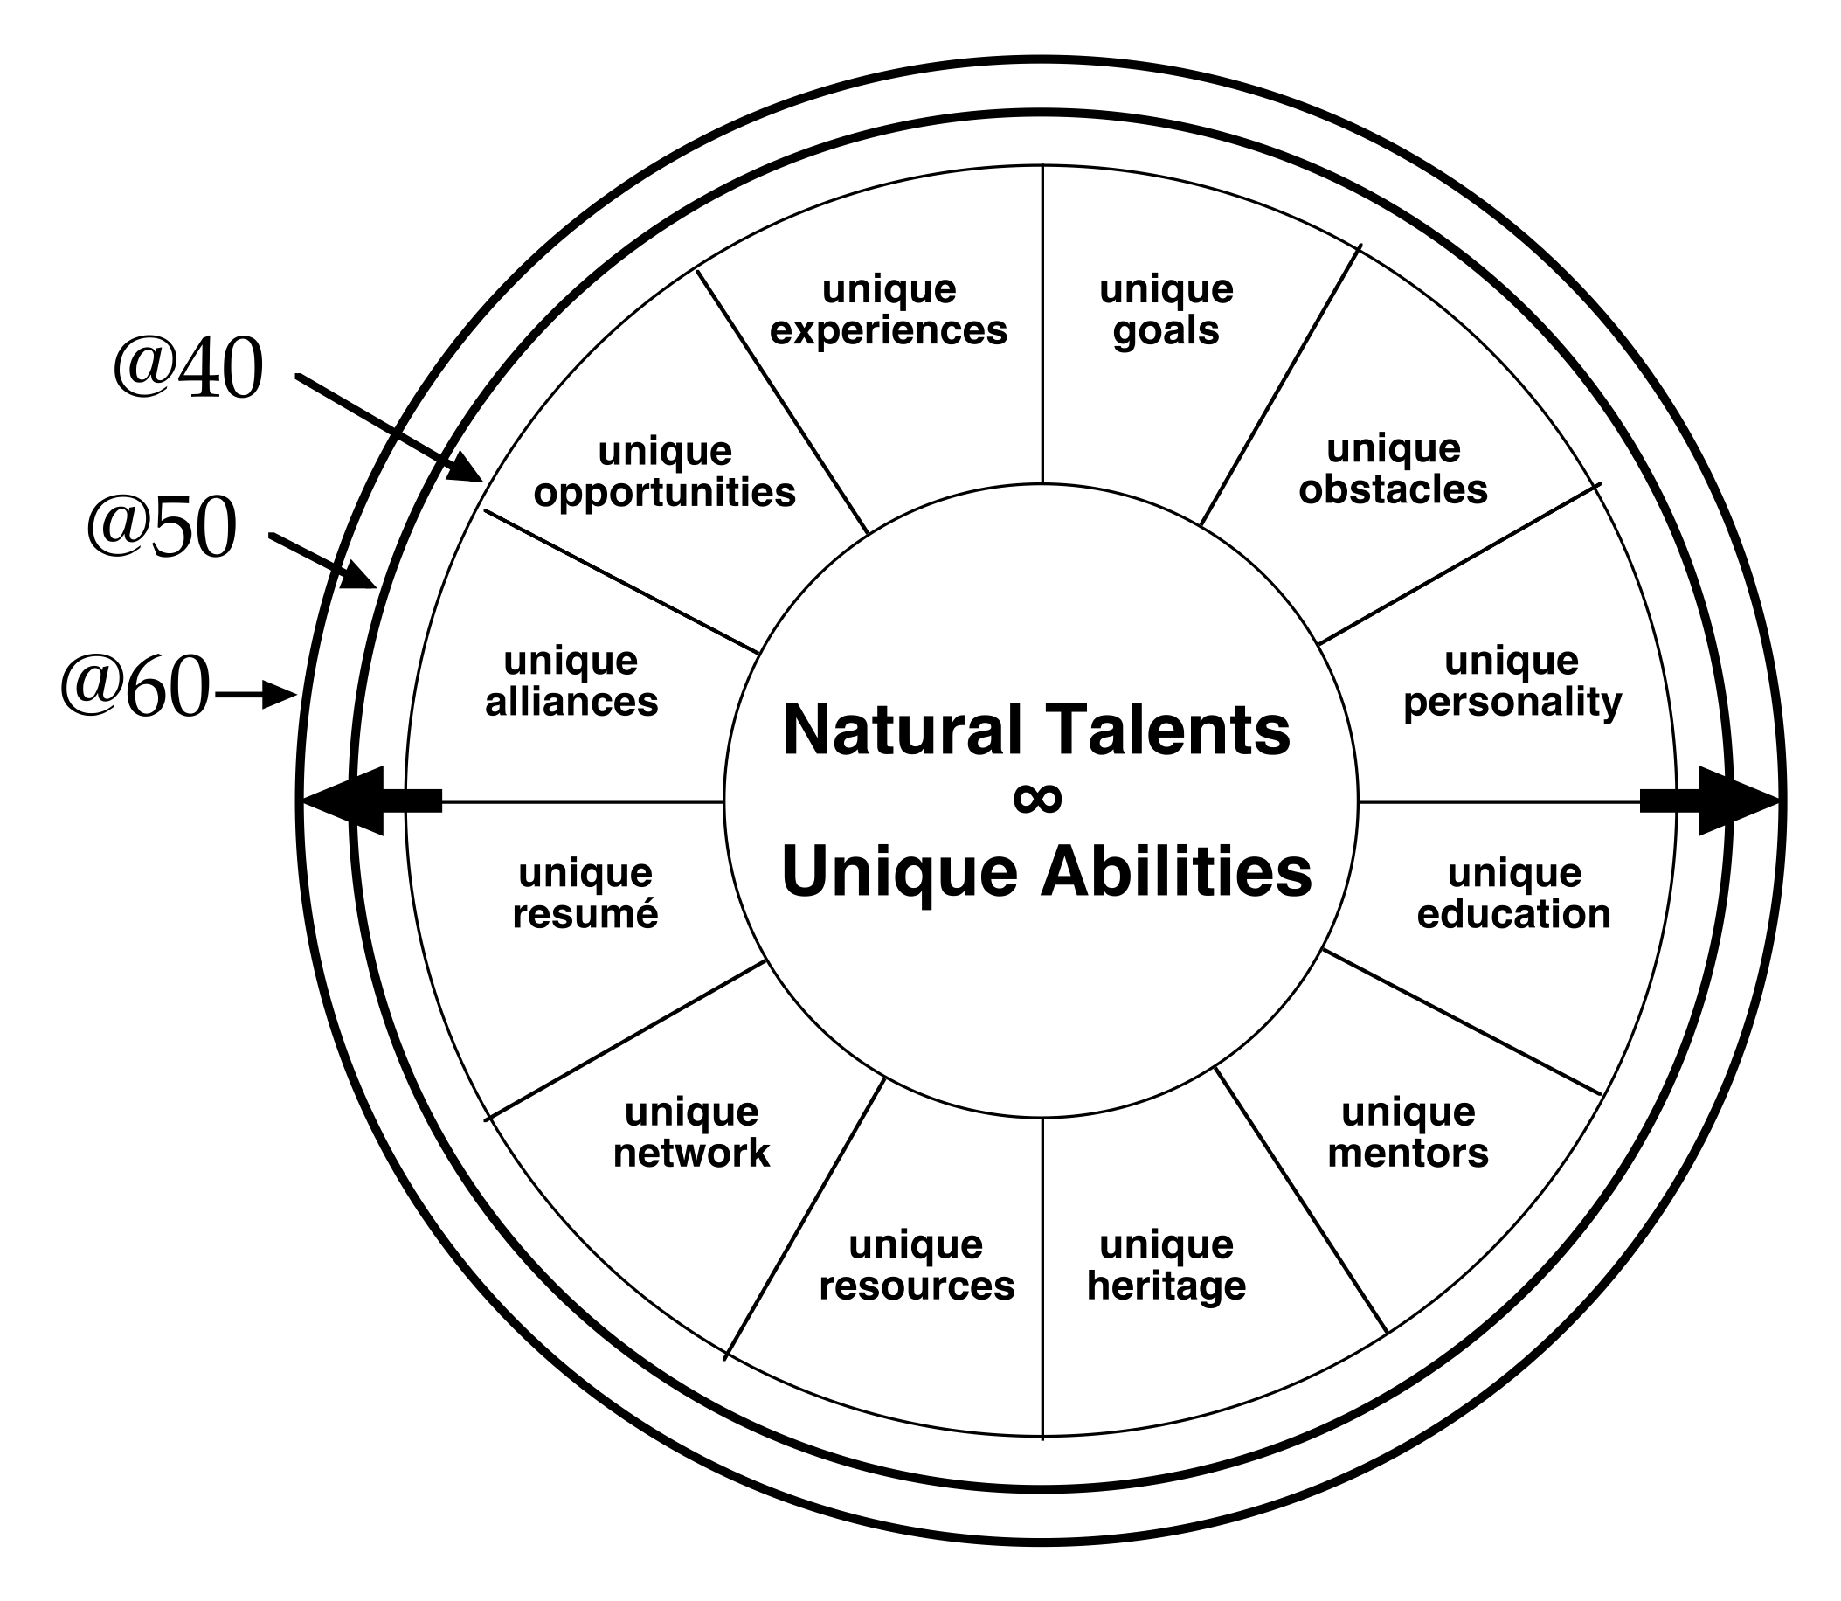
YOUR DISTINGUISHING CHARACTERISTICS
Potential
Notes:
We have 12 distinguishing characteristics
What they tell us is based on our unique history and experience how we will have the most influence.
Now it’s about seeing those having influence in the Kingdom space.

Slide 25
YOUR DISTINGUISHING CHARACTERISTICS
THINK:
VALUE TRANSFER
Potential
Notes:
Making them have a value transfer from world influence to kingdom influence.

Slide 26
VALUE TRANSFER
LOW: (1-3)
RESUME
RESOURCES
ALLIANCES
MODERATE: (4-6)
EDUCATION
NETWORK
MENTORS
GOALS
HIGH: (7-10)
PERSONALITY
OBSTACLES
HERITAGE
OPPORTUNITIES
EXPERIENCE
Potential
Notes:
Remember we rank them based on low moderate or high influence.
These will be different for every single individual.
It’s a picture of where God has brought you.

Slide 27
A LIFE OF GROWING DISTINCTIONS….
Potential
STOP GROWING…
….START DYING.
Notes:
As time passes and experiences happen these will change over time.

Slide 28
GOD-DESIGNED POTENTIAL
POTENTIAL
DISTINGUISHING
CHARACTERISTICS
DISTINGUISHING
CHARACTERISTICS
_____
_____
_____
_____
_____
TOP 5
STRENGTHS
Notes:
Battle Ready can lead you to the answers.
Battle Ready can lead you to the vision God has placed in you.
Battle Ready can show you but the hardest part is to actually remember what you have seen.
James 22 But be doers of the word and not hearers only, deceiving yourselves. 23 Because if anyone is a hearer of the word and not a doer, he is like someone looking at his own face[a] in a mirror. 24 For he looks at himself, goes away, and immediately forgets what kind of person he was.
The point is how are you going to ever use it if you don’t know who you are?
This is the beginning of your life focus dashboard. This is crucial.

Slide 29
GOD-DESIGNED POTENTIAL
SAMPLE FOCUS
DASHBOARD
POTENTIAL
PASSIONATE
ENCOURAGER
COACHING
WORLD CLASS COACH NETWORK
EDUCATION
WORLD TRAVEL
PODCASTING
AUTHOR
MISSION TRIPS
DISTINGUISHING
CHARACTERISTICS
DISTINGUISHING
CHARACTERISTICS
FUTURISTIC
STRATEGIC
ACTIVATOR
LEARNER
IDEATION
TOP 5
STRENGTHS
Notes:
Here is an example using my talents and characteristics
this is exactly how God has uniquely wired me for my mission.
The more I commit this to memory the more it help me understand where to put my hands to work in the kingdom space

Slide 30
PASSIONATE
ENCOURAGER
COACHING
WORLD CLASS COACH NETWORK
EDUCATION
WORLD TRAVEL
PODCASTING
AUTHOR
MISSION TRIPS
SAMPLE FOCUS
DASHBOARD
FUTURISTIC
STRATEGIC
ACTIVATOR
LEARNER
IDEATION
LIFE
MISSION
PASSION
PURPOSE
Notes:
At the end of the next module you will have a complete dashboard of passion, purpose and potential
This will be the definition of your life mission.
it should be a companion to your bible and journal so that you see it as often as you use those. It can’t live folded in a notebook.
You will spend time around the table discussing your potential today.

Slide 31
“YOUR LIFEMISSION DASHBOARD”
Notes:
Mission Critical
Daily, weekly basis
Talent from marketplace to Kingdom space
7day life
Talents are transitional

Slide 32
YOUR LIFEMISSION DASHBOARD
SPOUSE
CHILDREN
POTENTIAL
BODY
MIND
CAREER
SPIRIT
RESOURCES
SOUL
PASSION
PURPOSE
Notes:
Balance margin focus
the balance of your power core
time mastery and gaining margin
and focus on potential , passion and purpose
I jus mention the verse from James about the mirror and what a tragedy is is to forget ourselves.
The total dashboard is that mirror to examine your complete self.

Slide 33
YOUR PROGRESSION IN BATTLE READY
DESCRIBE AT LEAST ONE IMPROVEMENT IN EACH AREA:
BODY
MIND
SOUL
SPIRIT
MARRIAGE
KIDS
CAREER
FINANCES
SPOUSE
CHILDREN
BODY
MIND
CAREER
SPIRIT
RESOURCES
SOUL
Notes:
In the begging we started with our power core.
Remember the health of your power core, body, soul, mind spirit, bleeds over into the health of everything else
we create this dashboard in order to be able to constantly monitor where we are with body, mind, soul and spirit.
Those metrics are
am I getting stronger in my body, where have I been and where am I going when it comes to my physical well being
Is my mind gaining more control of my body,
Is my mind allowing the space for the spirit to lead.
am I relationally healthy in the soul.
The most important soul relationship God has given us our spouse, are we growing closer together and a top priority for one another.
Am I investing my wisdom in my children? (If you do battle ready right they won’t need it because they will have caught it from you)
Have I refinded my career from where it was 90 days ago?
How am I stewarding the resources place in my care?
This takes place every 90 days

Slide 34
YOUR EXPANSION OF MARGIN FOR LIFEMISSION
LIST TASKS ADDED OR SUBTRACTED IN THE LAST 90 DAYS:
EFFORTS ABANDONED
EFFORTS DELEGATED/SYSTEMIZED
EFFORTS INCREASED
TIME
SPENT
TIME INVESTED
EFFORTS RESULTS
Notes:
In Time leadership are we examine every 90 days and prunning time spent based on fruit produced?
This is all about multiplication of efforts that produce fruit.

Slide 35
YOUR KINGDOM CALLING
CONVERGENCE / LIFEMISSION
GOD’S KINGDOM POTENTIAL
GOD’S KINGDOM PASSION
GOD’S KINGDOM PURPOSE
POTENTIAL
PASSION
PURPOSE
Notes:
Slide

Slide 36
DISTINGUISHING
CHARACTERISTICS
POTENTIAL
ROLE
PASSIONATE
ENCOURAGER
COACHING
WORLD CLASS COACH NETWORK
EDUCATION
WORLD TRAVEL
PODCASTING
AUTHOR
MISSION TRIPS
FUTURISTIC
STRATEGIC
ACTIVATOR
LEARNER
IDEATION
TOP 5 STRENGTHS
PASSION
PURPOSE
SERVING MEN
SERVING MARRIAGES
DEVELOPING LEADERSHIP
MEN’S ISSUES
UNDERSTANDING PATRIARCHY
DEVELOP INFLUENCE
KINGDOM ENTREPRENEUR
MAKE DISCIPLES BY LEADING MEN TO LEADERSHIP OF ANYWHERE THEY PLACE THEIR FEET AND MINISTERING TO COUPLES ALONGSIDE SUZANNE IN A WAY THAT HAS A MEASURABLE IMPACT ON THE SUCCESS RATE OF MARRIAGES.
TYPES OF PEOPLE ISSUES
UNIQUE PURPOSE
Notes:
When we build this we bring in the areas we identified when we uncovered passion and purpose.
Slide:
Remember, passion and purpose are the driving forces for when things get hard, or seem impossible.
The MAIN point here is knowing is not enough…
It’s about the action taken that fits this dashboard.

Slide 37
YOUR SENSE OF CALLING / LIFE MISSION
TO WHICH CHAIR WILL YOU TRANSITION?
DESCRIBE THE TIMING.
THE WORK CHAIR
THE WOO CHAIR
TIME
FRIENDS
MONEY
INSIGHT
THE WEALTH CHAIR
THE WISDOM CHAIR
Notes:
Do you know the chair you are transistioning to and what the timing?
This is part of your dashboard.

Slide 38
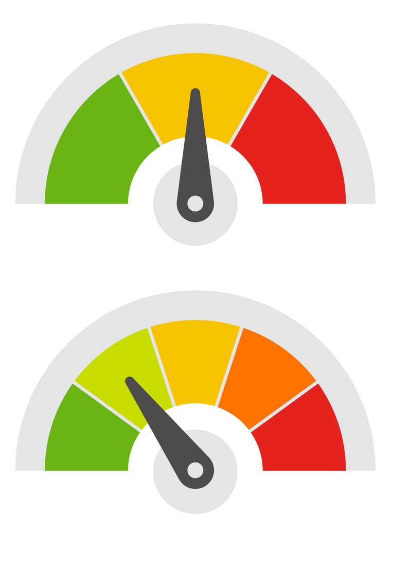
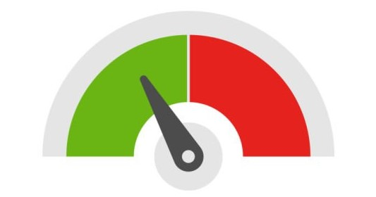
YOUR KINGDOM PORTFOLIO / LIFEMISSION
RELATIONSHIPS
STEWARDSHIP
LIABILITIES
(DEBTS OF DUTY)
SERVICE
(CALLING)
LEADERSHIP
Notes:
In what areas do we debts of gratitude to settle?

Slide 39
PATH OF LIFE
LIFE, BY
GOD’S DESIGN
CEILING OF COMPLEXITY
BATTLE READY
INFLECTION POINT
IMPACT OF INFLUENCE
LIFE, BY
CULTURAL DEFAULT
YOUTH ADULT ADULT II
Notes:
Remember in Battle Ready we are building a Kingdom Life Plan. Right now in this moment we are at the Battle Ready Inflection point. The point at which we intentionally make adjustments to increase in influence and blow through the ceiling of complexity
This is where the voices in our head tell us we have done enough, or even that we CAN’T do more.
You will spend some time around the table taking a deeper dive into filling out the areas on your dashboard

Slide 40
“YOUR KINGDOM PORTFOLIO”
Notes:
I just showed a slide with the kingdom portfolio. We are going to go a little deeper into this
Everything important in life requires design and planning
If it’s not important we shoot from the hip….
If it holds great significance we may spend years in designing and planning it out.
how would you build a house?
None of todays sections are about knowledge….they are all about action, and intention

Slide 41
FOCUS - 3RD STRATEGIC PILLAR
BEST- FOCUSED ON GOD’S PURPOSE IN ME.
STARVE “GOOD” FOR “GREAT”
BEST IS GOD’S PURPOSE IN ME IN ACTION
BETTER - WATCH OUT FOR GREENER PASTURES…
BUSY HAS ME BURY MY HEAD
FOCUS GROWS AND SO DO YOUR “NO’S”!!
BETTER- OPPORTUNITY SUCKERED
GOOD- I LIKE IT AND ITS PRODUCTIVE
BUSY- SOMEONE ELSE’S AGENDA
Notes:
we have gone though the first two pillars of power core an time mastery. This is about the third teir of focus.
Focus is diving in on what God created you for.
”You were built for such a time as this”
This is about learning to starve good for best

Slide 42
Notes:
Limited range

Slide 43
Notes:
This plane has a different capability

Slide 44
VFR vs. IFR
Notes:
Visual flight rules
instrument flight rules
what you can and can’t do under each
vfr requires good with and great sight of landmarks
Ifr allows for trust in instruments

Slide 45
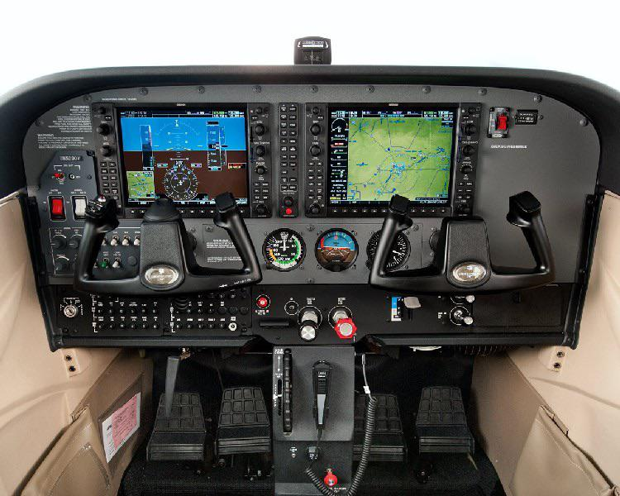
Notes:
Some instruments but not sophisticated.

Slide 46
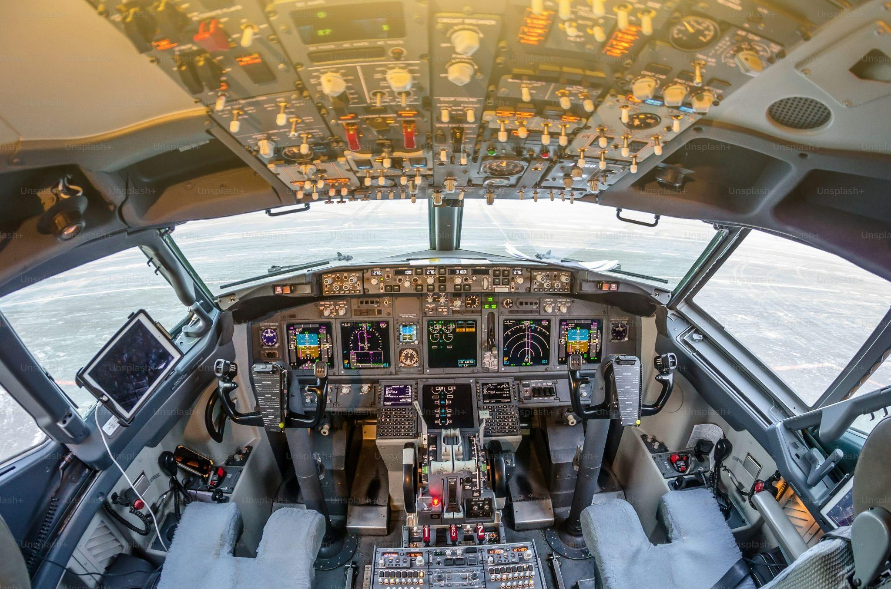
Notes:
The difference is how you handle turbulence
in turbulnace we shake
in turbulence we have to hold on truth
In turbulence we have to hold on to what we know so that we can push past and trough
What we are building is a IFR dashboard for your mission
IFR means you can go far
we don’t have to rely on what we can gather with our 5 senses

Slide 47
VFR vs. IFR
Notes:
Our 5 senses will lie to us if we allow them to in times of turbulence
Building this type of dashboard is going to require the MOST out of you
It‘s also the most exciting
But in the demands and excitement of my lifemission
If we are operating in what we feel in the moment rather than what’s planned with an
understanding of where we are going with intentionality we will be very susceptible to getting tripped up.
To go far and do incredible things we have to have the life plan in place to help it happen

Slide 48
KINGDOM LIFE PLAN
REVIEW ANNUALLY
4 KEY AREAS TO REVIEW
RELATIONSHIPS
LIABILITIES
INITIATIVES
GIVING
Notes:
The best way to review this is with a group that can hold you accountable.

Slide 49
RELATIONSHIPS - IN THE NEXT SEASON
GOD, WHO ARE THE…
CHRISTIANS I SHOULD FOCUS ON TO LEAD/COACH/GUIDE?
PRE-CHRISTIANS I SHOULD GUIDE TOWARDS YOU?
FOR EACH, WHAT IS MY ROLE:
TILL, PLANT, WATER, HARVEST, PROTECT, GROW MORE?
WHAT’S MY NEXT STEP WITH EACH PERSON?

Slide 50
LIABILITIES - IN THE NEXT SEASON
TO WHOM DO I HAVE A DEBT OF DUTY?
WHAT “GOOD” COMMITMENTS HAVE AN END NEEDED?
WHAT IS THE DATE THIS DEBT WILL BE COMPLETED OR IS IT ONGOING?
WHAT’S MY NEXT STEP FOR EACH PERSON?

Slide 51
INITIATIVES - IN THE NEXT SEASON
WHAT KINGDOM INITIATIVE AM I COMMITTED TO?
LOVE GOD, LOVE PEOPLE, MAKE FOLLOWERS
SCORE EACH ON A 1 TO 10:
K: IT’S GOT GOD’S HEART
: IT’S MY PASSION
ME: IT USES THE BEST OF ME
Notes:
Top 3-5
remember this is about focus
shelving now doesn’t mean shelving forever

Slide 52
GIVING - IN THE NEXT SEASON
LIFETIME GIVING GOAL:
LAST YEAR GIVING AMOUNT:
THIS YEAR GIVING TARGET (% AND OR $):
TARGETS:
-POOR -DUTY -LEADERSHIP -DISCIPLESHIP
-EVANGELISM -MY CALLING -OTHER
Notes:
This is to be done with your spouse if you are married of course.
Be BOLD….
This isn’t about gathering tax receipts. There may have been things that didn’t create a reciept
Rember these have to follow the rule of three as well…love God, love people, make followers

Slide 53
LIFEMISSION:
CHOOSE YOUR ROUTE

Slide 54
FOUND IT, FIND IT, FUND IT

Slide 55
FOUND IT
BE THE FOUNDER OF AN ENTREPRENEURIAL ADVENTURE FOR THE KING.
WHAT COULD BE STARTED BY YOU THAT WOULD BE ABOUT YOUR LIFEMISSION?

Slide 56
FIND IT
SEARCH OUT A GROUP DOING WHAT YOU ARE PASSIONATE ABOUT, THEN BRING THE GIFT ONLY YOUR CAN BRING.
WHO COULD YOUR TEAM UP WITH IN MISSION?

Slide 57
FOUND IT, FIND IT, FUND IT

Slide 58
FUND IT
FINANCE AN INITIATIVE AND BRING UNIQUE CONTRIBUTION TO A MISSION YOU CARE ABOUT.
COULD YOUR GIFT LEAD TO YOU HAVING MORE TO GIVE OR INFLUENCE AS A RESULT?

Slide 59
AROUND THE TABLE TIME

Slide 60
“The man who never reads will never be read; he who never quotes will never be quoted. He who will not use the thoughts of other men's brains, proves that he has no brains of his own.”
Charles Spurgeon

Slide 61
BATTLE READY 10 READING LIST
“UNLIMITED PARTNERSHIP: IGNITING A MARKETPLACE LEADER’S JOURNEY TO ETERNAL SIGNIFICANCE”
BY LlOYD REEB AND BILL WELLONS

Slide 62
www.battlereadyman.com

